Slide 1

Spring 2026 SAT® Suite: SAT School Day
Student Readiness Check

Slide 2

Student Readiness Check
Purpose of the Student Readiness Check:
Ensure devices being used for testing meet technical requirements
Ensure Bluebook is installed correctly
Complete Exam Set-Up process
  Review of test taker rules
  Includes providing optional test taker information
  Participation in BigFuture School and opt-in to Connections
Add up to 4 Free Score Sends
Complete Test Preview or Full-Length Practice Test
  Explore universal tools
  Answer sample questions
The student readiness check will take approximately 30 minutes without the full-length practice test.
Notes:
4 free score sends up to 3 days after a student tests.

Slide 3
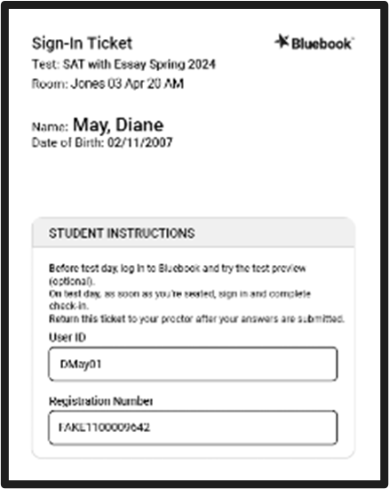
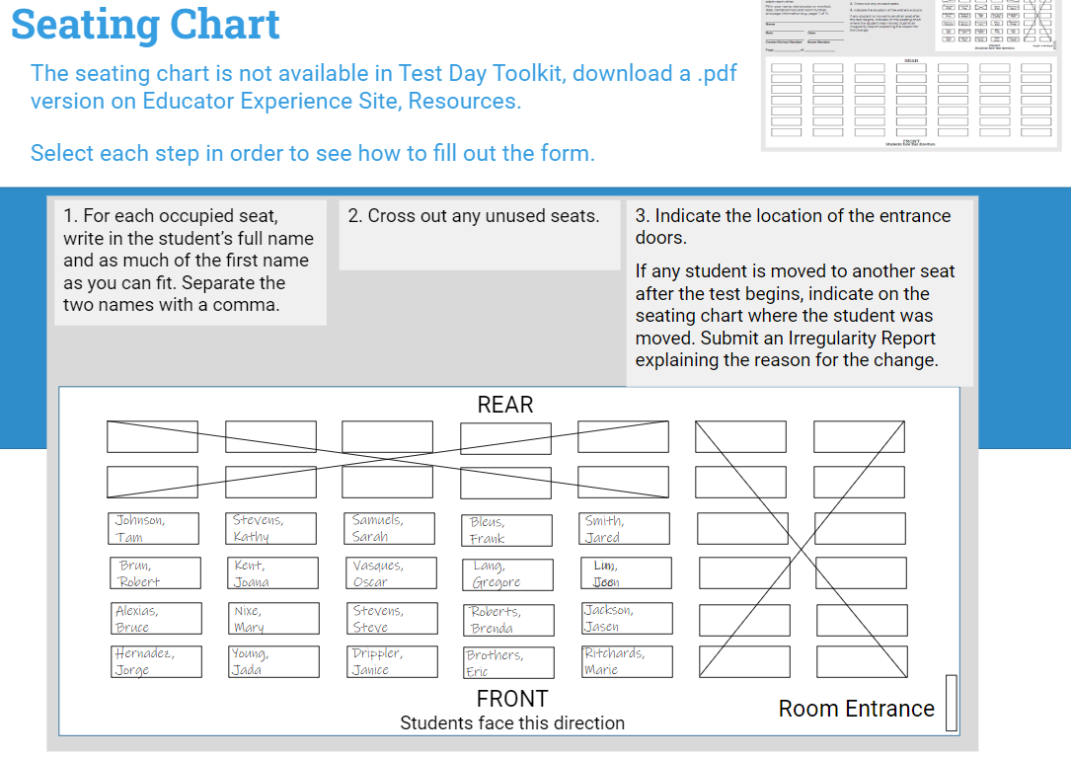
Take Your Seat and Receive Your Sign-In Ticket
Take your assigned seat
The proctor will give you a sign-in ticket

Slide 4


Power On Your Device & locate Bluebook™
Bluebook will either be an icon on your desktop
Or in your app menu
If you don’t see Bluebook on your desktop or in the app menu, restart your device.

Slide 5
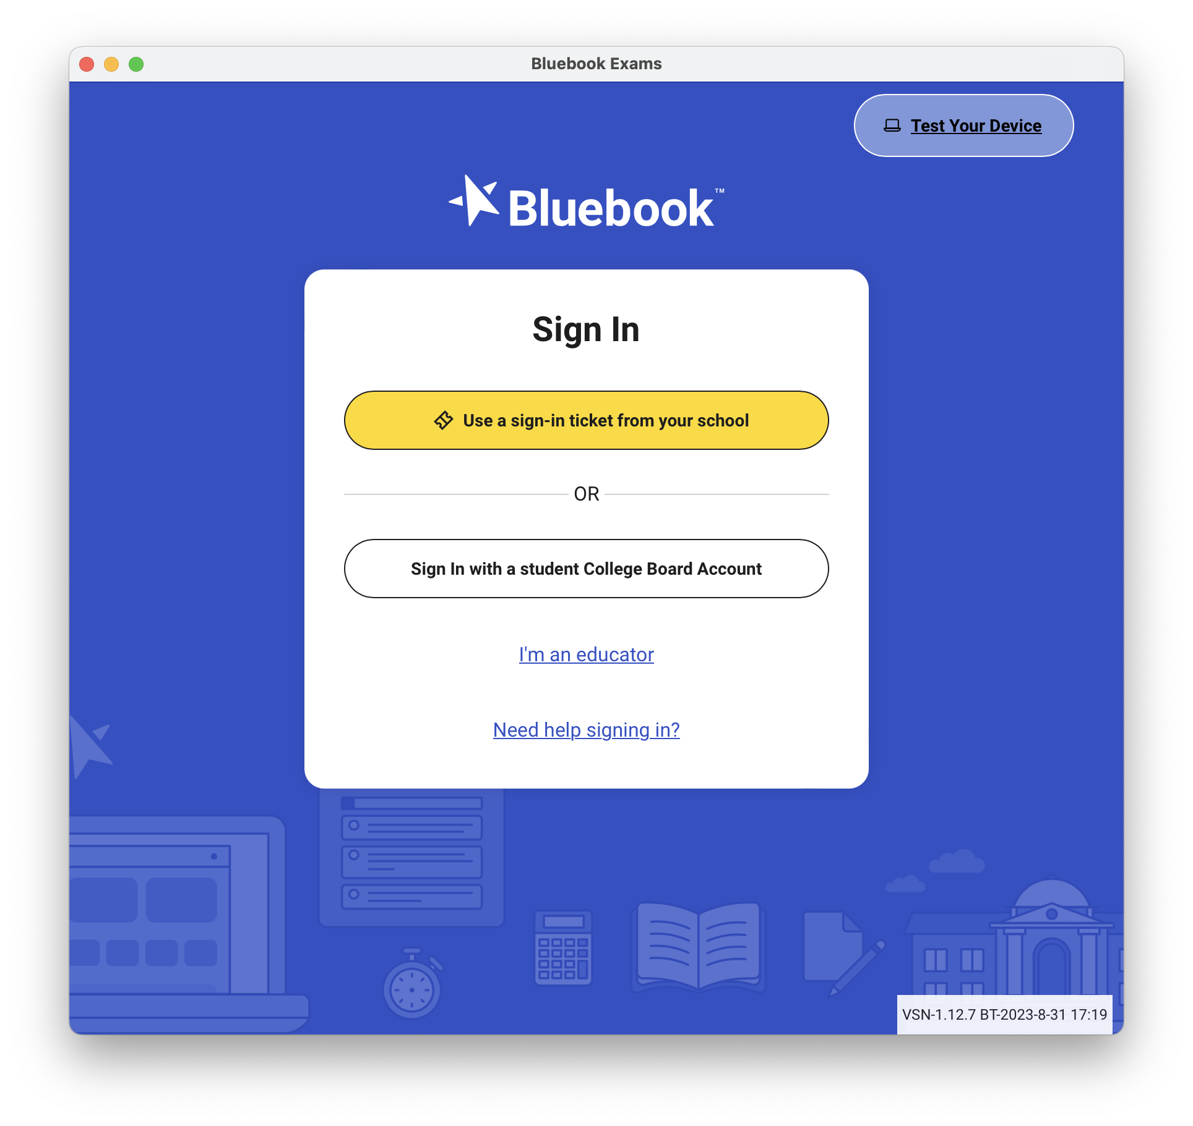
Test Your Device
Test your device before you sign in by selecting the Test Your Device button

Slide 6
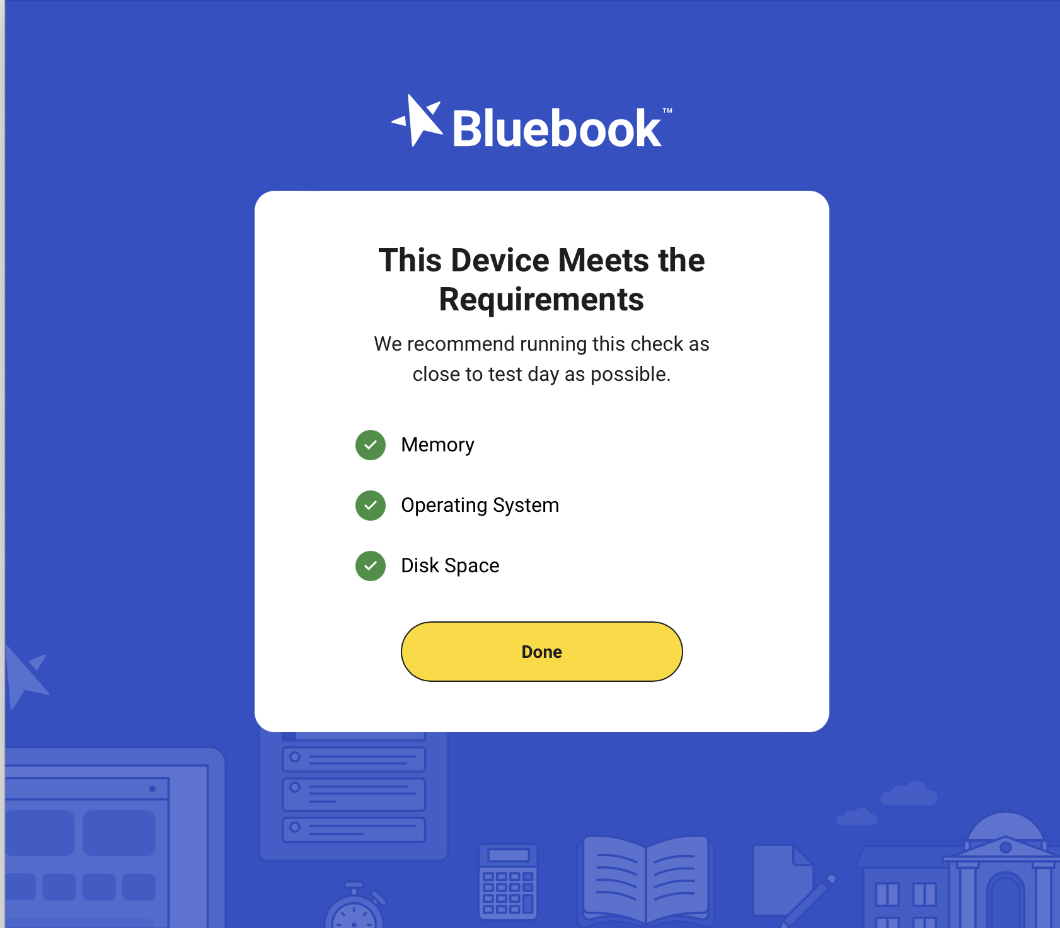

Test Your Device
If the device meets the requirements, select Done.
If the device does not meet the requirements, let your proctor know.

Slide 7
Sign into Bluebook
It is now time to sign in to Bluebook using the sign-in ticket you were provided.
You are signing in to set up for test day.

Slide 8
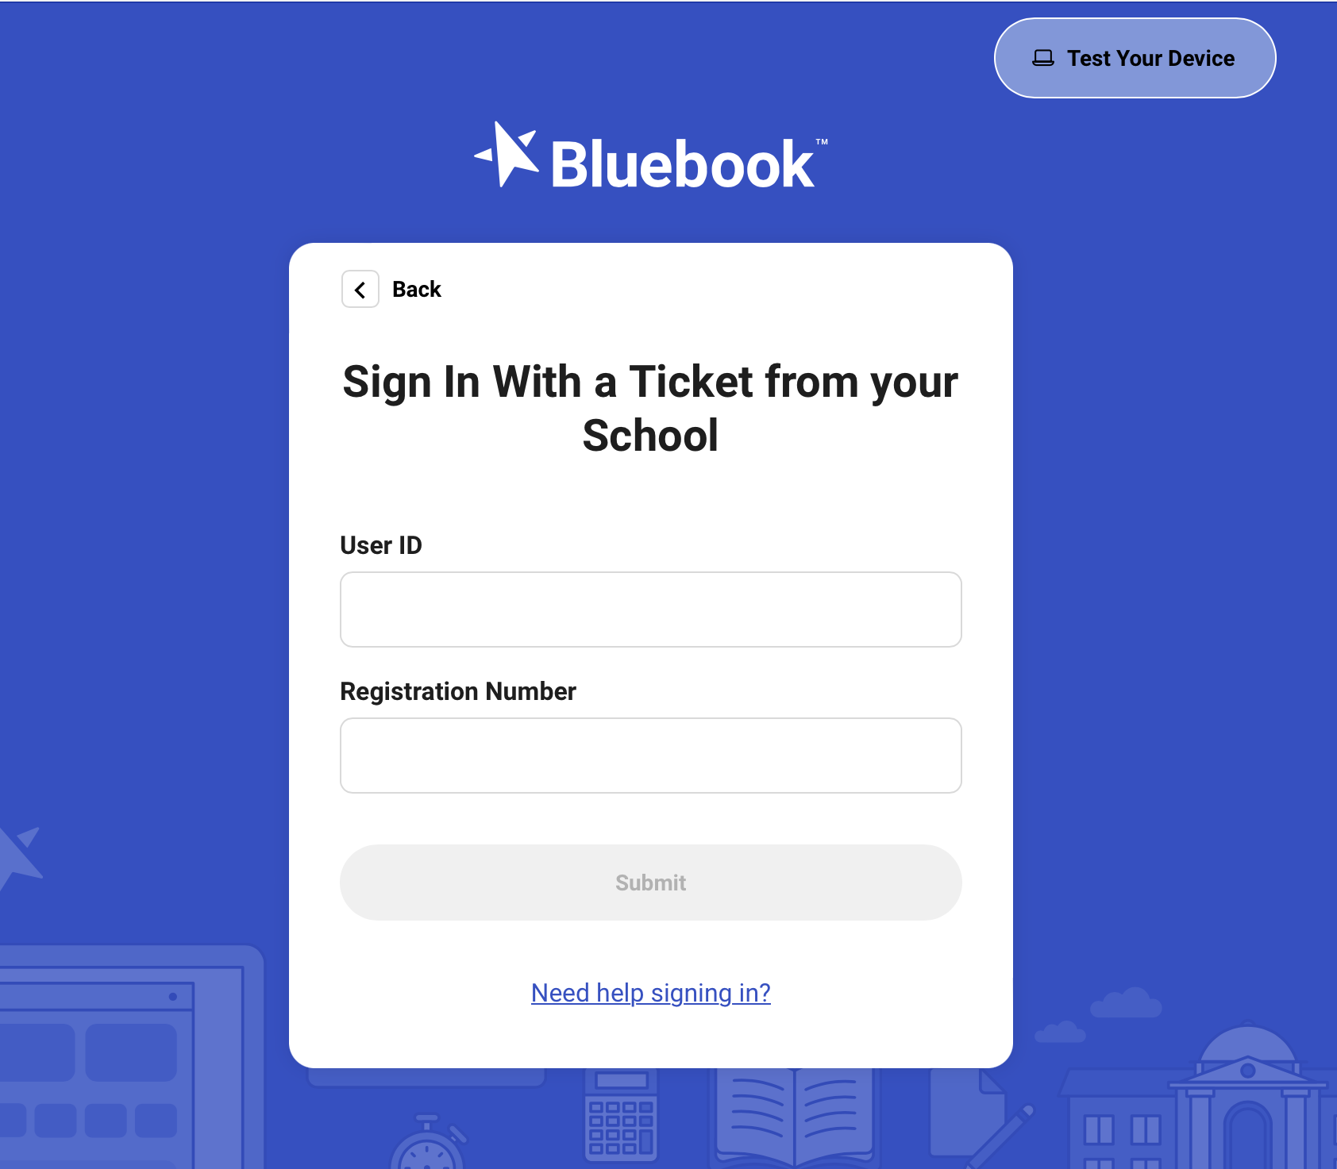
Sign into Bluebook
Your sign in ticket will have:
Your user ID
Your Registration Number

Slide 9
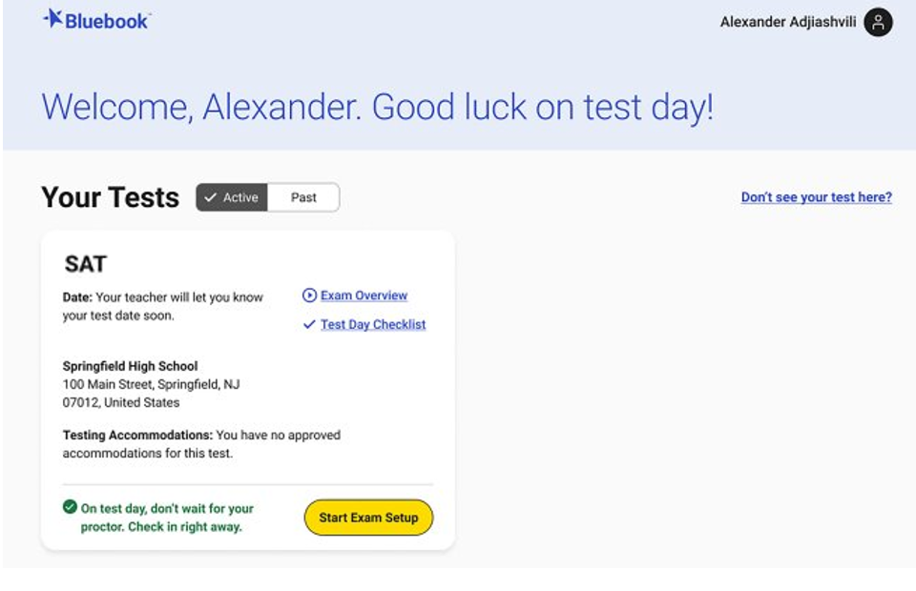
Compare Your Test Ticket and Bluebook
Ensure the correct test is displayed.
Ensure the correct school name is displayed.
(If applicable) Check that the correct accommodation/s are displayed

Slide 10
Start Exam Setup
If your test ticket and information in Bluebook match, you are ready to select Start Exam Setup.

Slide 11
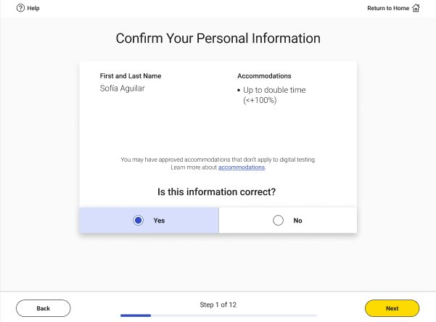
Step 1: Students Confirm Personal Information
Confirm that your name and approved accommodations (if applicable) are listed​. Then, click Next.
NOTE: If your accommodations look inaccurate, let me know. We cannot continue with exam setup until all issues are resolved.​
Notes:
On the first step of the Digital Readiness Check you will be asked to confirm that your personal information is correct.
Review the screen and make sure that the following information is right:
Your Name (First and Last)
Accommodations* (if you have any*)
If all the information is correct, click the yes button.
If no, raise your hand and let me know.

Slide 12
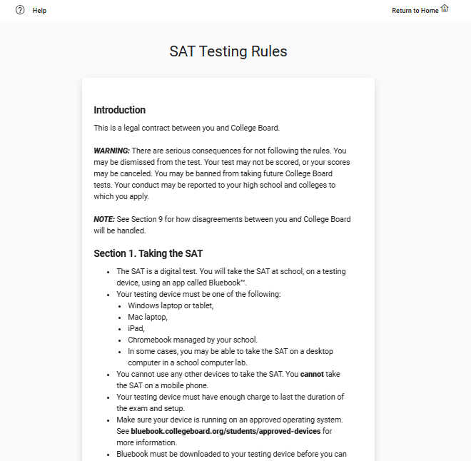
Step 2: Review & Agree to Test Taker Rules
Read and agree to the testing rules for the exam​. Type in the statement of agreement. Then, click Next.
Notes:
On step two, you are going to read and agree to the Test Rules.
This is an important agreement between you and College Board.
The test rules are a legally binding contract, and there are serious consequences to not following them.
Read each rule carefully.
When you finish, click “Yes.”

Slide 13
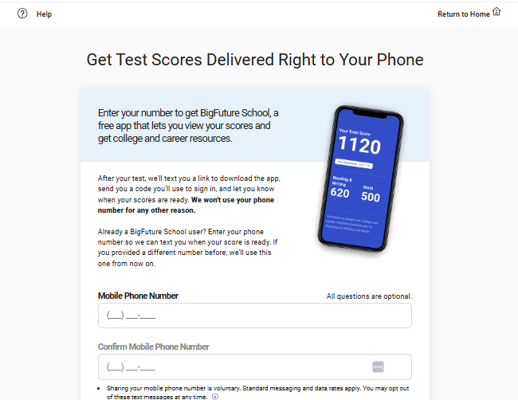
Step 3: BigFuture School Participation (Optional)
If you want to, you can opt-in to in BigFuture School, a free app that will allow you to see your scores on your phone when they are ready. To opt-in, enter your cell phone number, and click Next.
A signed data consent form needs to be on file with your school before opting into BigFuture School. Consent forms can be found in on the CDE Assessment Webpage.
If you do not want to opt-in, do not enter your cell phone number, and click Next.
Notes:
On step three, you may enter your phone number to get the BigFuture School app.
The BigFuture School app lets you view your scores and gain access to college and career resources.
You will receive 2 text messages from College Board: 1 to download the BigFuture School App, and 1 when your scores are ready.
You cannot opt-in to BigFuture School after Exam Set-up is complete.

Slide 14
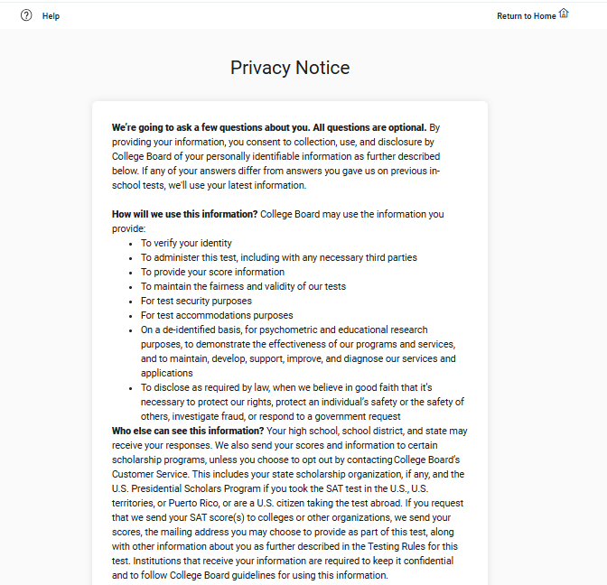
Step 4: Privacy Notice
Review the privacy notice. Then, click Next.​
Notes:
On step four, you will review and agree to the Privacy Notice.
You will learn how College Board will protect your personal information.
When you finish reading, click the “Yes” button.

Slide 15
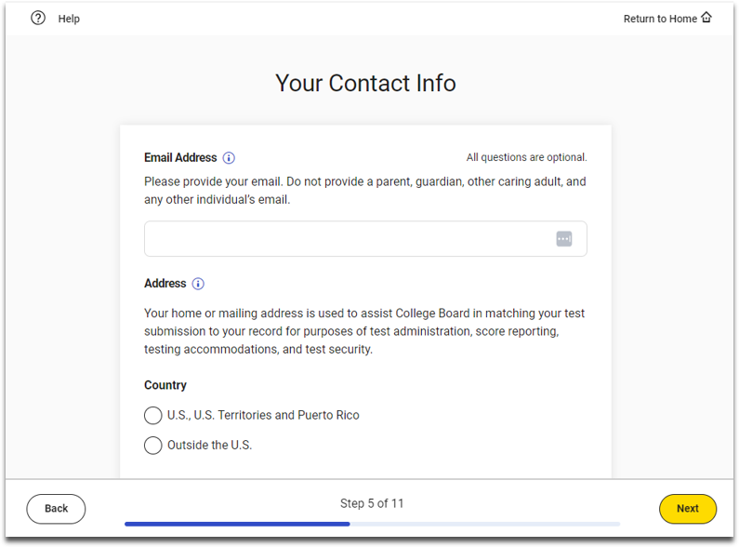
Step 5: Optional Student Information
If you want to, you may provide optional contact information, and then click Next.
If you do not wish to provide the optional information, simply click Next.
Notes:
On step five, you will be asked to provide your contact information. These questions are optional.
This information will be used to keep your test and test scores secure.
Fill out of your email address and mailing address.

Slide 16
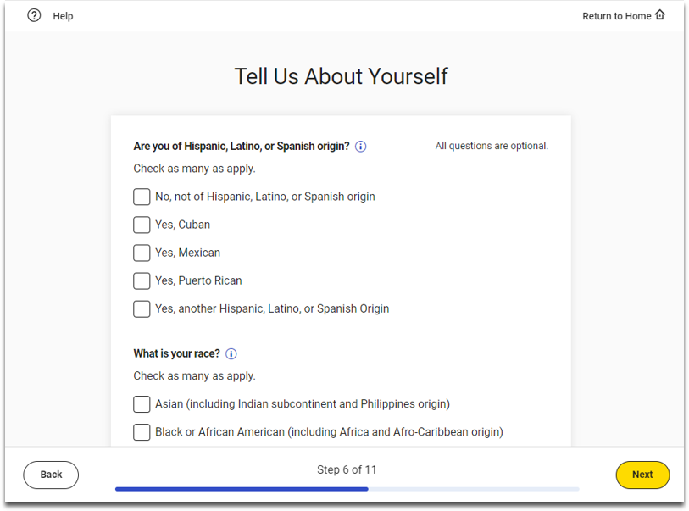
Step 6: Optional Student Information
On the screen that says Tell Us About Yourself, you may provide optional information about your demographics. Then, click Next.
If you do not wish to provide the optional information, simply click Next.
Notes:
On step six, you are asked to provide a little more information about yourself, like languages spoken at home. These questions are optional.

Slide 17
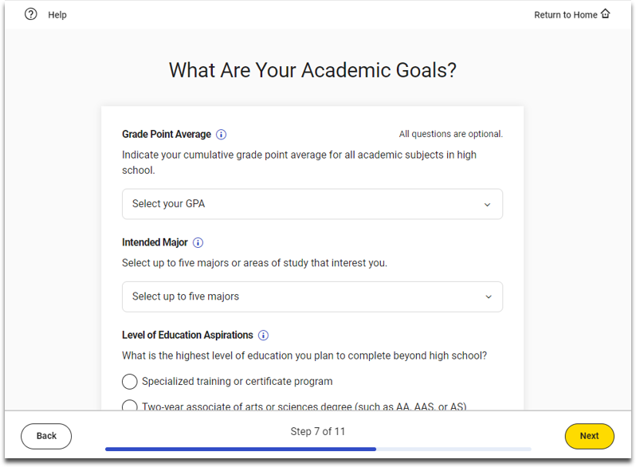
Step 7: Optional Student Information
Now, you may provide optional information about your academic goals. Then, click Next.
If you do not wish to provide this optional information, simply click Next.
Notes:
On step seven, you are asked to provide information about your academic goals. These questions are optional.

Slide 18
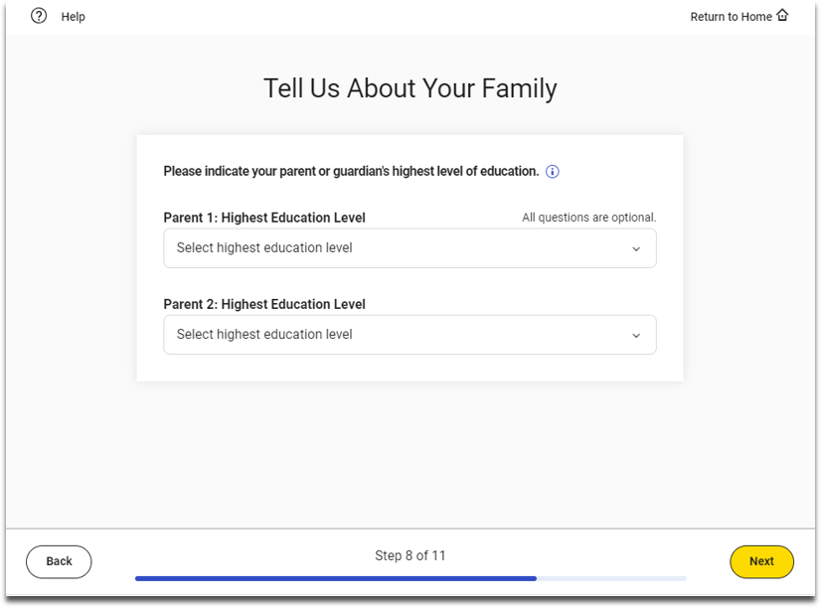
Step 8: Optional Student Information
On the screen that says Tell Us About Your Family, you may provide optional information about your family. Then, click Next.
If you do not wish to provide this optional information, simply click Next.
Notes:
On step eight, you are asked to tell us a bit more about your family. These questions are optional.

Slide 19
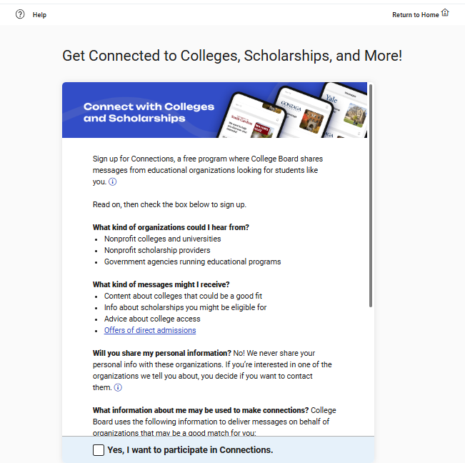
Step 9: Connections Opt-In (Optional)
Just like BigFuture School, Connections is free and optional. If you want to opt-in to Connections (which will allow you to get information about colleges, universities, and scholarship organizations), select the box that says “Yes, I want to participate in Connections” and click Next.
A signed data consent form needs to be on file with your school before opting into Connections. Consent forms can be found on the CDE Assessment Webpage.
If you do not want to opt-in, do not select the box, and click Next.
Notes:
On step nine, you will be asked to sign up for Connections.
Connections is a free program that connects you to scholarships, information about colleges, universities and career programs that may be a good fit for you.
Click on the checkbox to sign up for Connections.

Slide 20
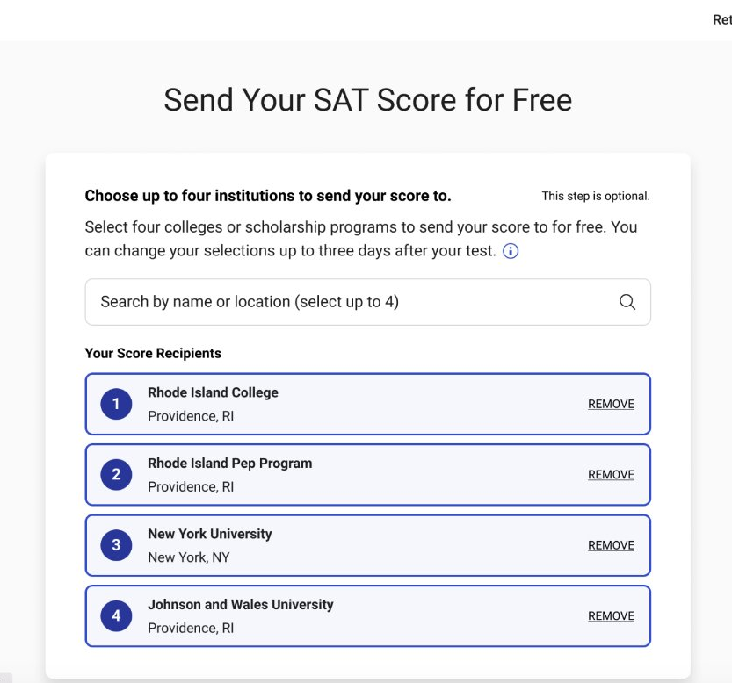

Step 10: Free Score Sends in Bluebook
Students will be able to request where to send their four free SAT School Day scores sends as part of Exam Set-Up.
Score send requests can be changed until three days after the student takes the test in Bluebook.
  Students will need to use their School Day sign-in ticket credentials to access Bluebook if they would like to add or change score send requests after testing is completed.
Notes:
On step ten, you can choose up to four colleges, universities, and scholarships to send your scores.
Make your selections.
This step is optional.

Slide 21
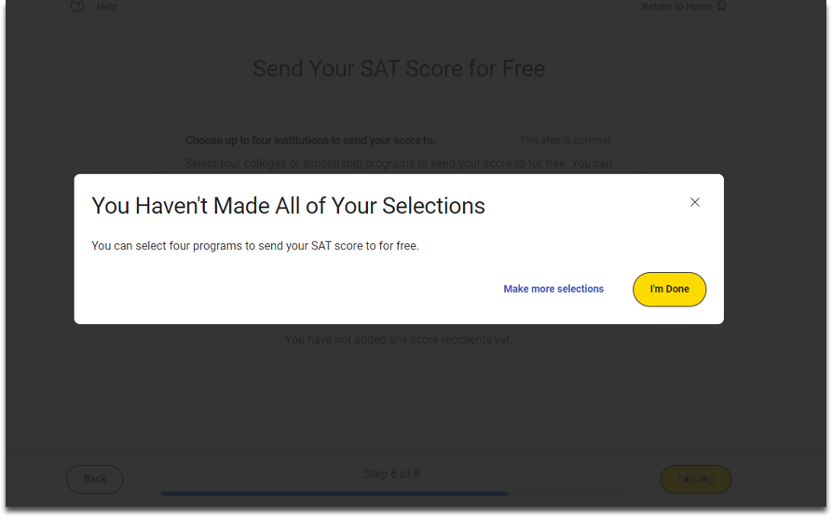
Step 10 Continued: SAT Free Score Sends (Optional)
If you receive a message stating that you haven’t made all of your selections, and it’s an error, click Make more selections. If it is not an error and you have made all your intended selections, click I’m Done.

Slide 22
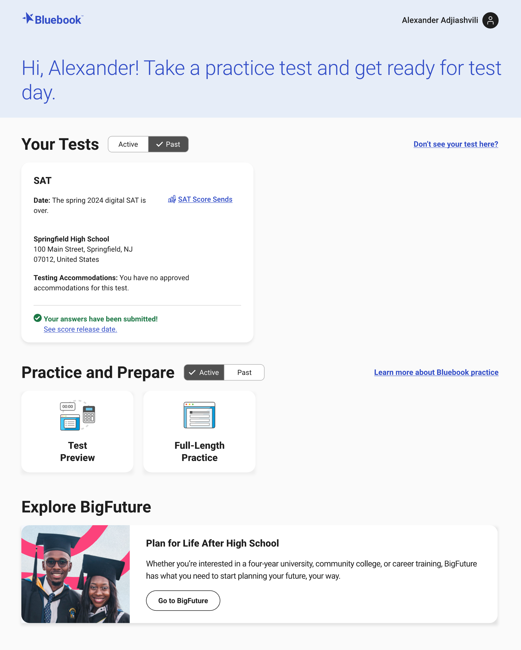
Step 10 Continued: Free Score Sends in Bluebook After Testing
Students can edit selections up to 3 days after testing.
Students must login to Bluebook using same credentials from sign-in ticket.
Select Active tab, and then the SAT Score Sends link
If testing is complete, select the Past tab, and then the SAT Score Sends link

Slide 23
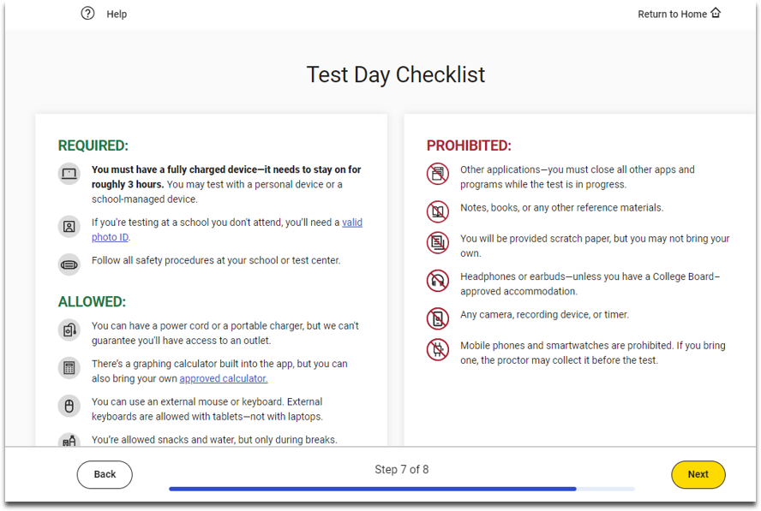
Step 11: Test Day Checklist
Review the Test Day Checklist and click Next.
Notes:
On step eleven, you will see valuable information about:
What you NEED to bring on test day.
Items allowed on test day.
Items prohibited on test day.

Slide 24
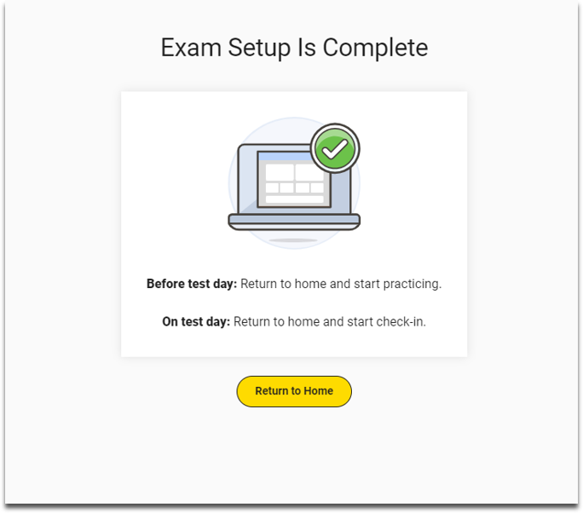
Step 12: Exam Set-Up Complete
Exam Setup is now complete.
Click Return to Home.
Notes:
On step eleven, you will see valuable information about:
What you NEED to bring on test day.
Items allowed on test day.
Items prohibited on test day.

Slide 25
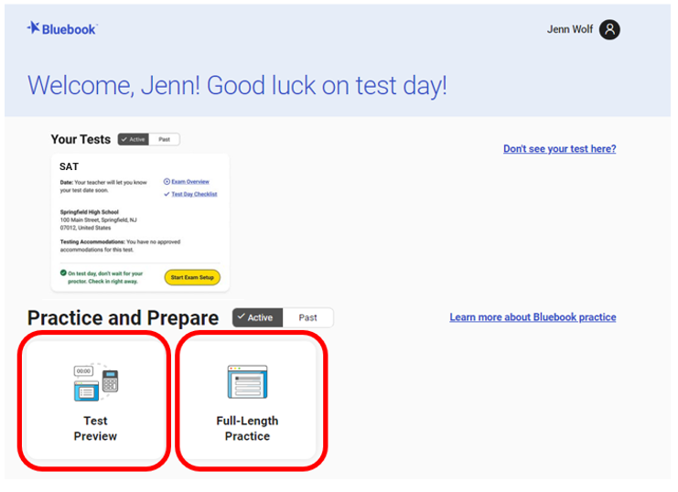
Test Preview and Full-Length Practice Test
Test Preview: A sample of questions from Reading & Writing and Math. Approximately 10-15 minutes in length. Not scored. No accommodations are available. Embedded Text-to-Speech available.
Full-Length Practice: Timed, full length practice SAT and PSAT tests. Scored. Accommodations available. Embedded Text-to-Speech available.
Paper full-length practice tests are also available to download via Full-Length Practice.
Note: While full-length practice tests are timed, students can move ahead or return to previous sections.

Slide 26
Your Student Readiness Check is Complete

