Slide 1



Spring 2025 Digital SAT and PSAT Testing
Parental Excuse and SAT / PSAT
Spring 2025
Notes:
A lot of information to share in our brief time together – I also want to hear your questions and welcome you sending them afterwards in email.
Let’s get to it.

Slide 2
Parental Excuse and SAT / PSAT
This slide deck provides guidance on the application of parent excuse coding for SAT/PSAT. This coding complements state statute which requires local education providers to establish a process that allows parents to excuse their child from state content assessment participation. Since the parent excuse code became available and as recently as last summer, districts have discovered and reported instances of local inadvertent parent excuse miscoding for students who completed testing. In these cases, students, parents, and educators expected to receive results; however, the parent excuse coding processed and prevented the production of scores.
This year’s process will include automated checks to ensure that students who participate fully in state content assessments receive a score. These checks will prevent incompatible coding (i.e., parent excuse) for students who had the opportunity to engage with PSAT/SAT testing.
In the rare case that a parent excusal from participation in the state assessment is received while a student is actively participating in a SAT/PSAT testing room, the following guidance includes the steps that will allow the processing of a parent excuse code.
The number of records impacted by this update should be extremely limited.
This is a 2-step process:
  Submit an irregularity report
  Apply the parental excuse code (code 9)
For internal use only
Notes:
Coordinators will set up each of their testing rooms from the All Rooms tab. They can also see all rooms that have been set up in Test Day Toolkit, whether or not a proctor has been assigned, the capacity of each testing room and how many students have been pre-rostered to that room if the coordinator opts to preassign students to rooms in Test Day Toolkit.
These are more like testing sessions, so coordinators will need to set up more than 1 room even if they plan to use the same physical space over multiple days of testing. This will allow us to be able to easily identify who was impacted by an IR.
If you’re testing in the same room multiple times, you must add a room in Test Day Toolkit for each session to create unique student rosters.
Use this naming convention for rooms you’re reusing: Add the month and day after the room name. If necessary, add the time, too. Use letters and numbers only. For example, create rooms called “Cafeteria Mar 6 AM” and “Cafeteria Mar 6 PM” if you’re using the cafeteria to test one group in the morning and another group in the afternoon.
Assigning proctors to multiple rooms will not be supported in Spring ‘24. If a proctor is being used for multiple days of testing, they will need to be deleted from the room and added to the next day’s room after testing is complete. Or they can remain unassigned and the proctor can pick the correct room from the list.

Slide 3
Parental Excuse During Testing
College Board will process and report scores for all students who answer any test items, unless they are invalidated by College Board due to a testing irregularity. College Board does not use CDE Special Reporting Use/Reason Not Tested codes when processing scores.
If a parent excuses their student from participating in the PSAT or SAT prior to the start of testing, the student should not enter a physical testing room and the student’s record should be coded with 9 for parental excuse in the Special Use Only field within the student’s profile in Test Day Toolkit. A parent excuse code applied to a student record for these students who did not enter College Board’s Bluebook student testing app will be processed and will appear in CDE’s final data.
A parent excuse code will not be processed and will not appear in CDE’s final data if the student started testing and submitted responses in any test module with the following exception.
For internal use only
Notes:
Coordinators will set up each of their testing rooms from the All Rooms tab. They can also see all rooms that have been set up in Test Day Toolkit, whether or not a proctor has been assigned, the capacity of each testing room and how many students have been pre-rostered to that room if the coordinator opts to preassign students to rooms in Test Day Toolkit.
These are more like testing sessions, so coordinators will need to set up more than 1 room even if they plan to use the same physical space over multiple days of testing. This will allow us to be able to easily identify who was impacted by an IR.
If you’re testing in the same room multiple times, you must add a room in Test Day Toolkit for each session to create unique student rosters.
Use this naming convention for rooms you’re reusing: Add the month and day after the room name. If necessary, add the time, too. Use letters and numbers only. For example, create rooms called “Cafeteria Mar 6 AM” and “Cafeteria Mar 6 PM” if you’re using the cafeteria to test one group in the morning and another group in the afternoon.
Assigning proctors to multiple rooms will not be supported in Spring ‘24. If a proctor is being used for multiple days of testing, they will need to be deleted from the room and added to the next day’s room after testing is complete. Or they can remain unassigned and the proctor can pick the correct room from the list.

Slide 4
Parental Excuse During Testing
Student Removed from Testing Room Due to Parent Excuse:
In the rare instance that a student needs to be removed during an active testing session in response to a parent excusal:
Immediately after the test session ends, the student must be reported to College Board in Test Day Toolkit through the Irregularities page. To prevent any risk of creating a wider scale irregularity issue that could impact other students, in this situation it would be best to wait for the scheduled section break (between reading/writing and math) to remove the student.
The student’s record should be coded with 9 for parental excuse in the Special Reporting Use/Reason Not Tested Code field, either within Test Day Toolkit or during SBD. If a testing irregularity is not submitted and there is a score in the final file, the Parental Excuse will not be processed.
More information on providing special reporting use/reason not tested codes including parent excusals is available on page 42 of the Spring 2026 Colorado SAT Suite of Assessments Test Coordinator Manual. Guidance on how District Data Respondents can verify and update these codes during the Student Biographical Review (SBD) data clean-up window will be provided during SBD training.
To complete steps 1 and 2 in Test Day Toolkit as described above, please follow the guidance on the following slides.
For internal use only
Notes:
Coordinators will set up each of their testing rooms from the All Rooms tab. They can also see all rooms that have been set up in Test Day Toolkit, whether or not a proctor has been assigned, the capacity of each testing room and how many students have been pre-rostered to that room if the coordinator opts to preassign students to rooms in Test Day Toolkit.
These are more like testing sessions, so coordinators will need to set up more than 1 room even if they plan to use the same physical space over multiple days of testing. This will allow us to be able to easily identify who was impacted by an IR.
If you’re testing in the same room multiple times, you must add a room in Test Day Toolkit for each session to create unique student rosters.
Use this naming convention for rooms you’re reusing: Add the month and day after the room name. If necessary, add the time, too. Use letters and numbers only. For example, create rooms called “Cafeteria Mar 6 AM” and “Cafeteria Mar 6 PM” if you’re using the cafeteria to test one group in the morning and another group in the afternoon.
Assigning proctors to multiple rooms will not be supported in Spring ‘24. If a proctor is being used for multiple days of testing, they will need to be deleted from the room and added to the next day’s room after testing is complete. Or they can remain unassigned and the proctor can pick the correct room from the list.

Slide 5
Part One: Submit an Irregularity Report

Slide 6
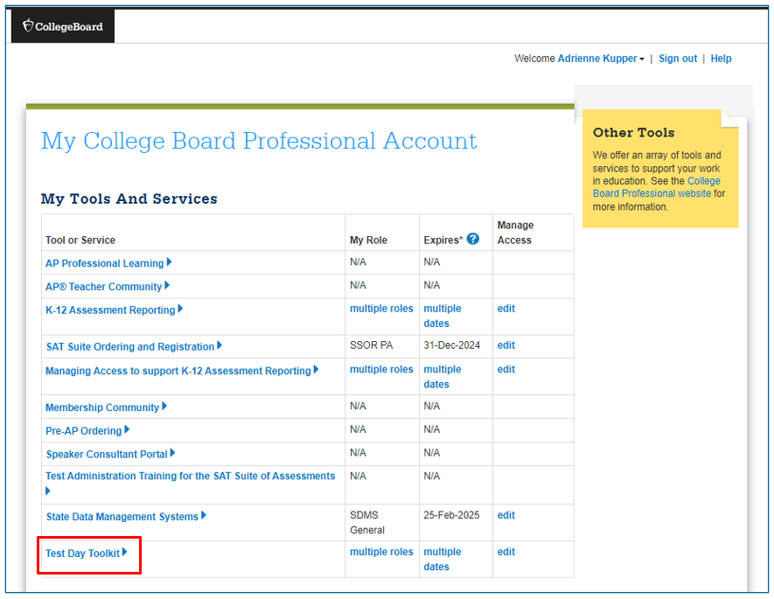
Login to Test Day Toolkit
Sign into Test Day Toolkit. There are two ways to do this. The first is to access the application from your College Board Educator Account dashboard.
The other option is to sign in https://testday.collegeboard.org/.
For internal use only
Notes:
Coordinators will set up each of their testing rooms from the All Rooms tab. They can also see all rooms that have been set up in Test Day Toolkit, whether or not a proctor has been assigned, the capacity of each testing room and how many students have been pre-rostered to that room if the coordinator opts to preassign students to rooms in Test Day Toolkit.
These are more like testing sessions, so coordinators will need to set up more than 1 room even if they plan to use the same physical space over multiple days of testing. This will allow us to be able to easily identify who was impacted by an IR.
If you’re testing in the same room multiple times, you must add a room in Test Day Toolkit for each session to create unique student rosters.
Use this naming convention for rooms you’re reusing: Add the month and day after the room name. If necessary, add the time, too. Use letters and numbers only. For example, create rooms called “Cafeteria Mar 6 AM” and “Cafeteria Mar 6 PM” if you’re using the cafeteria to test one group in the morning and another group in the afternoon.
Assigning proctors to multiple rooms will not be supported in Spring ‘24. If a proctor is being used for multiple days of testing, they will need to be deleted from the room and added to the next day’s room after testing is complete. Or they can remain unassigned and the proctor can pick the correct room from the list.

Slide 7
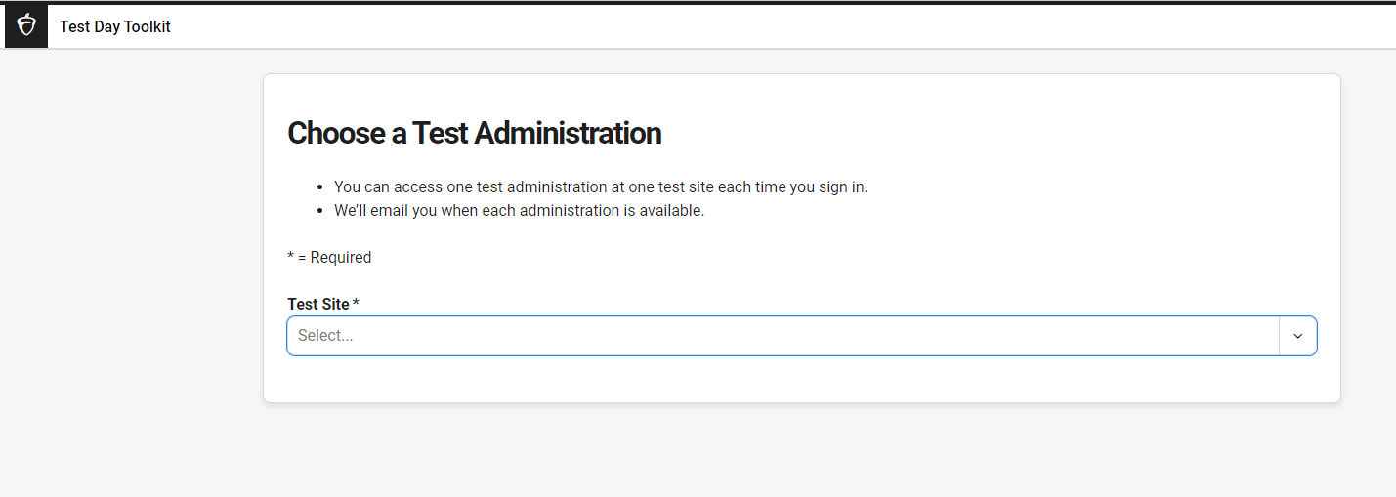
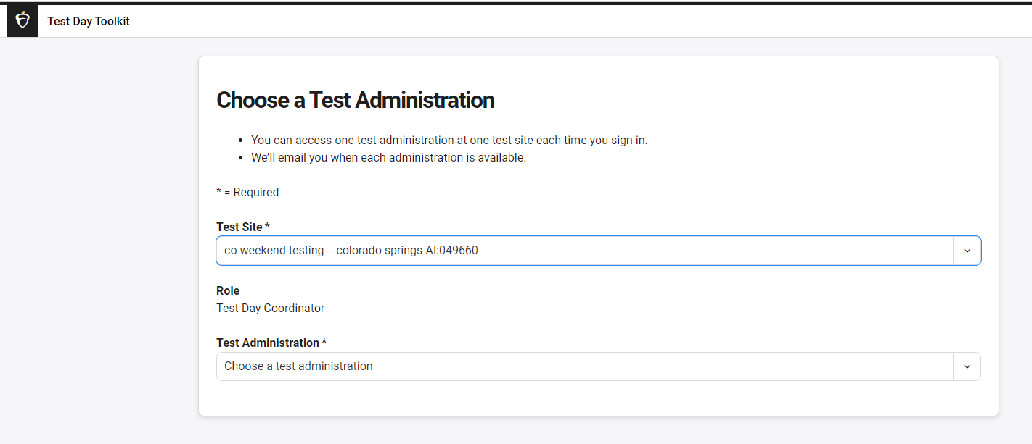
Choose Your Test Administration
Chose your test site from the dropdown menu.
Then, chose the test administration and assessment from the dropdown menu.
For internal use only
Notes:
Coordinators will set up each of their testing rooms from the All Rooms tab. They can also see all rooms that have been set up in Test Day Toolkit, whether or not a proctor has been assigned, the capacity of each testing room and how many students have been pre-rostered to that room if the coordinator opts to preassign students to rooms in Test Day Toolkit.
These are more like testing sessions, so coordinators will need to set up more than 1 room even if they plan to use the same physical space over multiple days of testing. This will allow us to be able to easily identify who was impacted by an IR.
If you’re testing in the same room multiple times, you must add a room in Test Day Toolkit for each session to create unique student rosters.
Use this naming convention for rooms you’re reusing: Add the month and day after the room name. If necessary, add the time, too. Use letters and numbers only. For example, create rooms called “Cafeteria Mar 6 AM” and “Cafeteria Mar 6 PM” if you’re using the cafeteria to test one group in the morning and another group in the afternoon.
Assigning proctors to multiple rooms will not be supported in Spring ‘24. If a proctor is being used for multiple days of testing, they will need to be deleted from the room and added to the next day’s room after testing is complete. Or they can remain unassigned and the proctor can pick the correct room from the list.

Slide 8
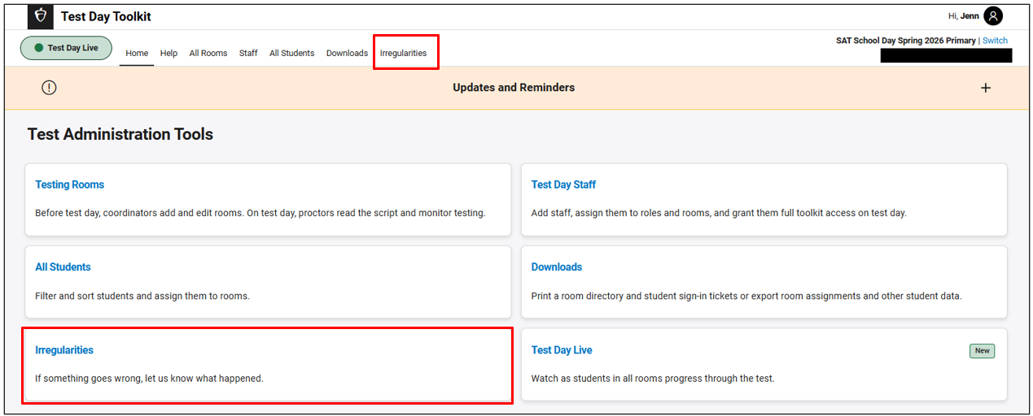
Navigate to Irregularities
On the Test Day Toolkit home page, click the Irregularities tab or choose the Irregularities tile.
For internal use only
Notes:
Coordinators will set up each of their testing rooms from the All Rooms tab. They can also see all rooms that have been set up in Test Day Toolkit, whether or not a proctor has been assigned, the capacity of each testing room and how many students have been pre-rostered to that room if the coordinator opts to preassign students to rooms in Test Day Toolkit.
These are more like testing sessions, so coordinators will need to set up more than 1 room even if they plan to use the same physical space over multiple days of testing. This will allow us to be able to easily identify who was impacted by an IR.
If you’re testing in the same room multiple times, you must add a room in Test Day Toolkit for each session to create unique student rosters.
Use this naming convention for rooms you’re reusing: Add the month and day after the room name. If necessary, add the time, too. Use letters and numbers only. For example, create rooms called “Cafeteria Mar 6 AM” and “Cafeteria Mar 6 PM” if you’re using the cafeteria to test one group in the morning and another group in the afternoon.
Assigning proctors to multiple rooms will not be supported in Spring ‘24. If a proctor is being used for multiple days of testing, they will need to be deleted from the room and added to the next day’s room after testing is complete. Or they can remain unassigned and the proctor can pick the correct room from the list.

Slide 9
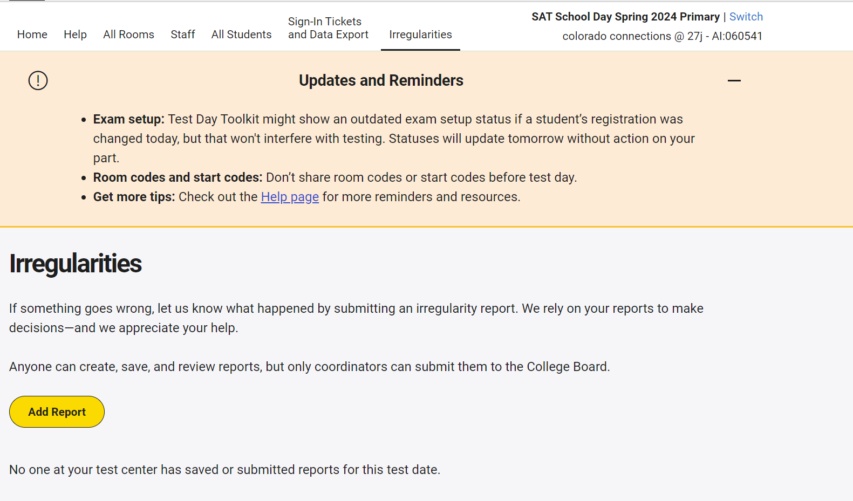
Add an Irregularity Report
Next, choose the yellow Add Report button.
For internal use only
Notes:
Coordinators will set up each of their testing rooms from the All Rooms tab. They can also see all rooms that have been set up in Test Day Toolkit, whether or not a proctor has been assigned, the capacity of each testing room and how many students have been pre-rostered to that room if the coordinator opts to preassign students to rooms in Test Day Toolkit.
These are more like testing sessions, so coordinators will need to set up more than 1 room even if they plan to use the same physical space over multiple days of testing. This will allow us to be able to easily identify who was impacted by an IR.
If you’re testing in the same room multiple times, you must add a room in Test Day Toolkit for each session to create unique student rosters.
Use this naming convention for rooms you’re reusing: Add the month and day after the room name. If necessary, add the time, too. Use letters and numbers only. For example, create rooms called “Cafeteria Mar 6 AM” and “Cafeteria Mar 6 PM” if you’re using the cafeteria to test one group in the morning and another group in the afternoon.
Assigning proctors to multiple rooms will not be supported in Spring ‘24. If a proctor is being used for multiple days of testing, they will need to be deleted from the room and added to the next day’s room after testing is complete. Or they can remain unassigned and the proctor can pick the correct room from the list.

Slide 10
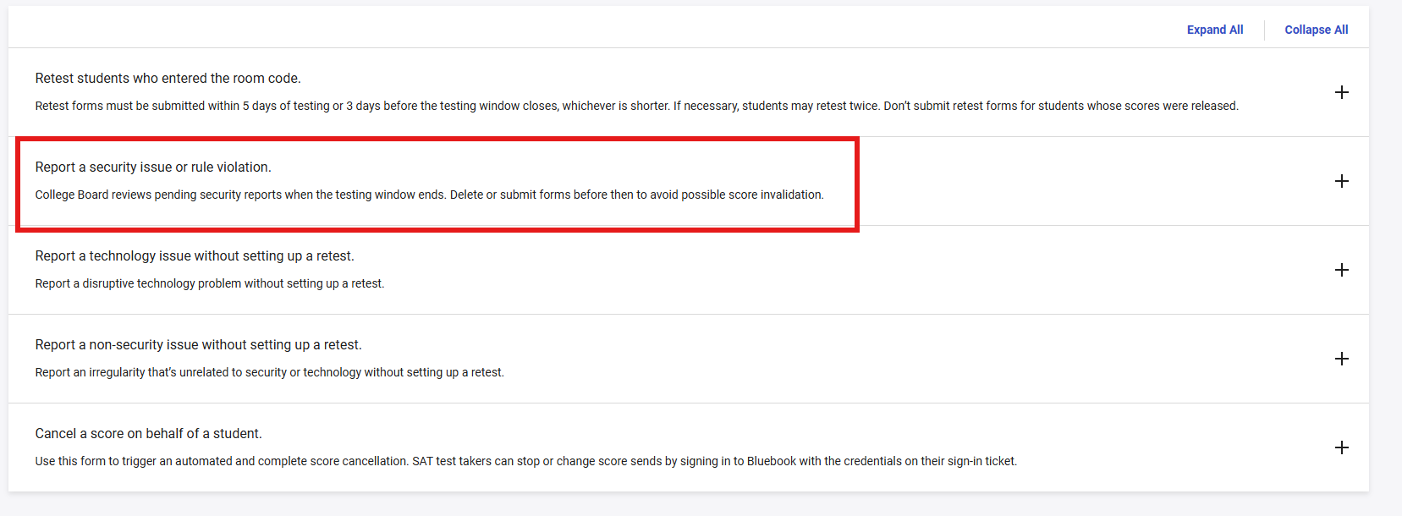
Report a security issue or rule violation
Choose Report a security issue or rule violation.
For internal use only
Notes:
Coordinators will set up each of their testing rooms from the All Rooms tab. They can also see all rooms that have been set up in Test Day Toolkit, whether or not a proctor has been assigned, the capacity of each testing room and how many students have been pre-rostered to that room if the coordinator opts to preassign students to rooms in Test Day Toolkit.
These are more like testing sessions, so coordinators will need to set up more than 1 room even if they plan to use the same physical space over multiple days of testing. This will allow us to be able to easily identify who was impacted by an IR.
If you’re testing in the same room multiple times, you must add a room in Test Day Toolkit for each session to create unique student rosters.
Use this naming convention for rooms you’re reusing: Add the month and day after the room name. If necessary, add the time, too. Use letters and numbers only. For example, create rooms called “Cafeteria Mar 6 AM” and “Cafeteria Mar 6 PM” if you’re using the cafeteria to test one group in the morning and another group in the afternoon.
Assigning proctors to multiple rooms will not be supported in Spring ‘24. If a proctor is being used for multiple days of testing, they will need to be deleted from the room and added to the next day’s room after testing is complete. Or they can remain unassigned and the proctor can pick the correct room from the list.

Slide 11
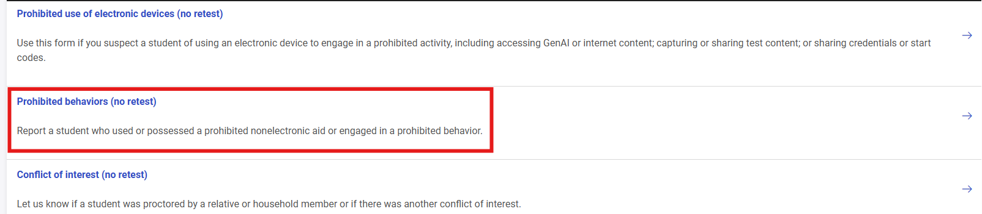
Prohibited behaviors (no retest)
Then choose Prohibited behaviors (no retest)
For internal use only
Notes:
Coordinators will set up each of their testing rooms from the All Rooms tab. They can also see all rooms that have been set up in Test Day Toolkit, whether or not a proctor has been assigned, the capacity of each testing room and how many students have been pre-rostered to that room if the coordinator opts to preassign students to rooms in Test Day Toolkit.
These are more like testing sessions, so coordinators will need to set up more than 1 room even if they plan to use the same physical space over multiple days of testing. This will allow us to be able to easily identify who was impacted by an IR.
If you’re testing in the same room multiple times, you must add a room in Test Day Toolkit for each session to create unique student rosters.
Use this naming convention for rooms you’re reusing: Add the month and day after the room name. If necessary, add the time, too. Use letters and numbers only. For example, create rooms called “Cafeteria Mar 6 AM” and “Cafeteria Mar 6 PM” if you’re using the cafeteria to test one group in the morning and another group in the afternoon.
Assigning proctors to multiple rooms will not be supported in Spring ‘24. If a proctor is being used for multiple days of testing, they will need to be deleted from the room and added to the next day’s room after testing is complete. Or they can remain unassigned and the proctor can pick the correct room from the list.

Slide 12
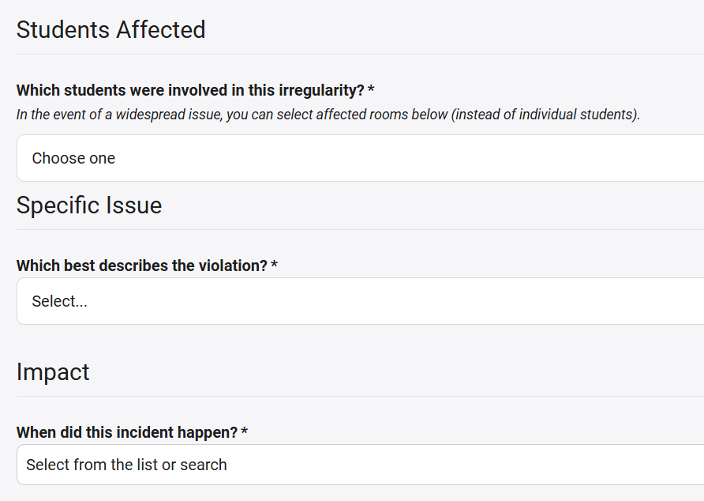
Irregularity Details
In the Students Affected field, choose the correct student in the dropdown.
Specific Issue: Choose ‘Other’
Impact: Select ‘Before Timed Testing’ if they had not begun the actual test. If the student began the test, choose the section and module they stopped.
1
2
3
For internal use only
This presentation will be posted in the Colorado Resource Repository.
Notes:
Coordinators will set up each of their testing rooms from the All Rooms tab. They can also see all rooms that have been set up in Test Day Toolkit, whether or not a proctor has been assigned, the capacity of each testing room and how many students have been pre-rostered to that room if the coordinator opts to preassign students to rooms in Test Day Toolkit.
These are more like testing sessions, so coordinators will need to set up more than 1 room even if they plan to use the same physical space over multiple days of testing. This will allow us to be able to easily identify who was impacted by an IR.
If you’re testing in the same room multiple times, you must add a room in Test Day Toolkit for each session to create unique student rosters.
Use this naming convention for rooms you’re reusing: Add the month and day after the room name. If necessary, add the time, too. Use letters and numbers only. For example, create rooms called “Cafeteria Mar 6 AM” and “Cafeteria Mar 6 PM” if you’re using the cafeteria to test one group in the morning and another group in the afternoon.
Assigning proctors to multiple rooms will not be supported in Spring ‘24. If a proctor is being used for multiple days of testing, they will need to be deleted from the room and added to the next day’s room after testing is complete. Or they can remain unassigned and the proctor can pick the correct room from the list.

Slide 13
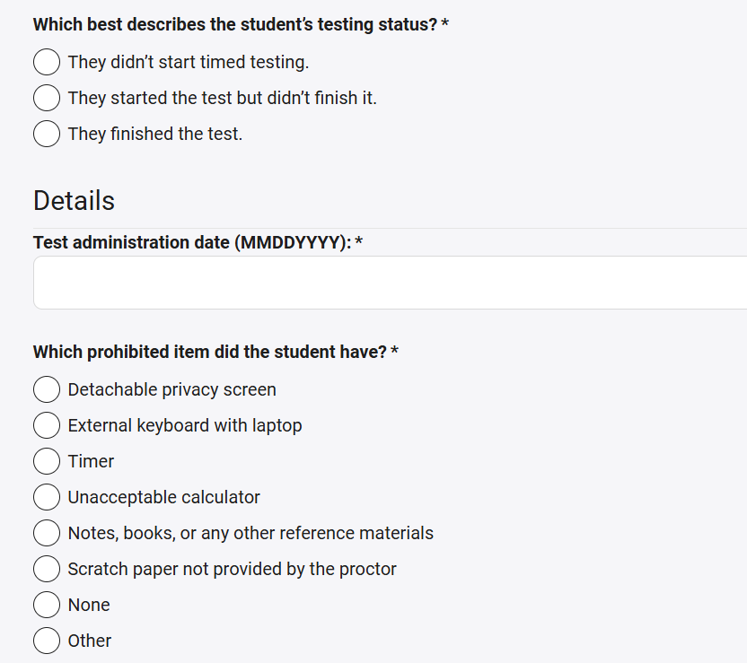
Details about the Irregularity
4
What best describes the student’s test status? Select the appropriate answer.
Enter the test administration date.
Then, choose None from the list of prohibited items.
5
6
For internal use only
This presentation will be posted in the Colorado Resource Repository.
Notes:
Coordinators will set up each of their testing rooms from the All Rooms tab. They can also see all rooms that have been set up in Test Day Toolkit, whether or not a proctor has been assigned, the capacity of each testing room and how many students have been pre-rostered to that room if the coordinator opts to preassign students to rooms in Test Day Toolkit.
These are more like testing sessions, so coordinators will need to set up more than 1 room even if they plan to use the same physical space over multiple days of testing. This will allow us to be able to easily identify who was impacted by an IR.
If you’re testing in the same room multiple times, you must add a room in Test Day Toolkit for each session to create unique student rosters.
Use this naming convention for rooms you’re reusing: Add the month and day after the room name. If necessary, add the time, too. Use letters and numbers only. For example, create rooms called “Cafeteria Mar 6 AM” and “Cafeteria Mar 6 PM” if you’re using the cafeteria to test one group in the morning and another group in the afternoon.
Assigning proctors to multiple rooms will not be supported in Spring ‘24. If a proctor is being used for multiple days of testing, they will need to be deleted from the room and added to the next day’s room after testing is complete. Or they can remain unassigned and the proctor can pick the correct room from the list.

Slide 14
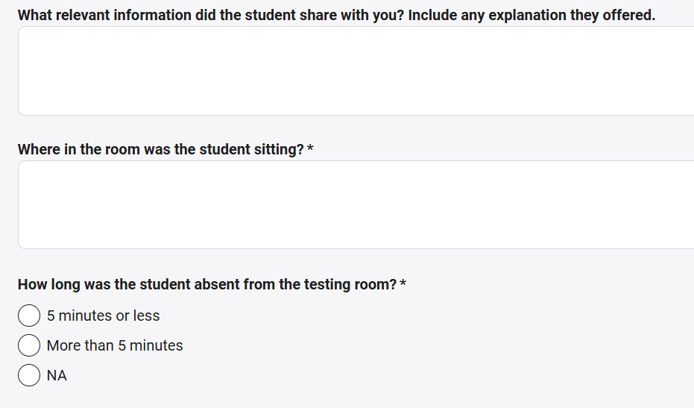
Information about the Irregularity
Optional: Provide any information from the student that may be relevant.
Indicate where in the room the student was seated for the exam.
Since this irregularity is not about a student leaving the testing room, select NA for this question.
7
8
9
For internal use only
This presentation will be posted in the Colorado Resource Repository.
Notes:
Coordinators will set up each of their testing rooms from the All Rooms tab. They can also see all rooms that have been set up in Test Day Toolkit, whether or not a proctor has been assigned, the capacity of each testing room and how many students have been pre-rostered to that room if the coordinator opts to preassign students to rooms in Test Day Toolkit.
These are more like testing sessions, so coordinators will need to set up more than 1 room even if they plan to use the same physical space over multiple days of testing. This will allow us to be able to easily identify who was impacted by an IR.
If you’re testing in the same room multiple times, you must add a room in Test Day Toolkit for each session to create unique student rosters.
Use this naming convention for rooms you’re reusing: Add the month and day after the room name. If necessary, add the time, too. Use letters and numbers only. For example, create rooms called “Cafeteria Mar 6 AM” and “Cafeteria Mar 6 PM” if you’re using the cafeteria to test one group in the morning and another group in the afternoon.
Assigning proctors to multiple rooms will not be supported in Spring ‘24. If a proctor is being used for multiple days of testing, they will need to be deleted from the room and added to the next day’s room after testing is complete. Or they can remain unassigned and the proctor can pick the correct room from the list.

Slide 15
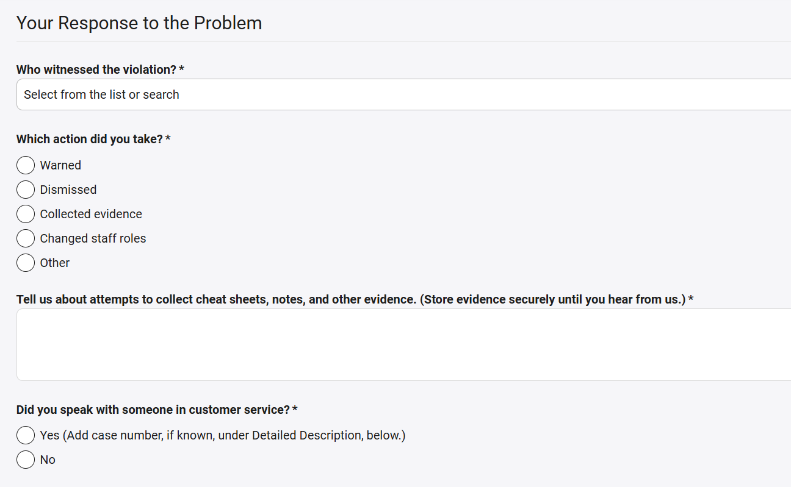
Educator Response to the Irregularity
For the question asking who witnessed the violation, choose I witnessed it myself.
Next, choose Dismissed to indicate the action taken.
Type N/A
Select No
9
10
11
12
For internal use only
This presentation will be posted in the Colorado Resource Repository.
Notes:
Coordinators will set up each of their testing rooms from the All Rooms tab. They can also see all rooms that have been set up in Test Day Toolkit, whether or not a proctor has been assigned, the capacity of each testing room and how many students have been pre-rostered to that room if the coordinator opts to preassign students to rooms in Test Day Toolkit.
These are more like testing sessions, so coordinators will need to set up more than 1 room even if they plan to use the same physical space over multiple days of testing. This will allow us to be able to easily identify who was impacted by an IR.
If you’re testing in the same room multiple times, you must add a room in Test Day Toolkit for each session to create unique student rosters.
Use this naming convention for rooms you’re reusing: Add the month and day after the room name. If necessary, add the time, too. Use letters and numbers only. For example, create rooms called “Cafeteria Mar 6 AM” and “Cafeteria Mar 6 PM” if you’re using the cafeteria to test one group in the morning and another group in the afternoon.
Assigning proctors to multiple rooms will not be supported in Spring ‘24. If a proctor is being used for multiple days of testing, they will need to be deleted from the room and added to the next day’s room after testing is complete. Or they can remain unassigned and the proctor can pick the correct room from the list.

Slide 16
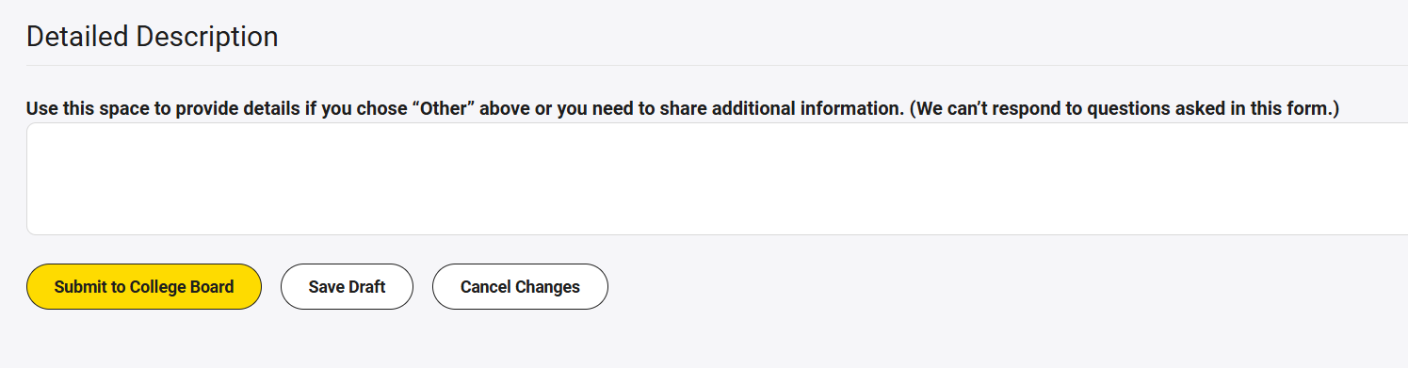
Description of Irregularity
Finally, type the following statement in the Detailed Description field: “This student was not eligible for testing due to a parent excuse and was removed from the test session after testing started. The score MUST BE invalidated using invalidation code 24 and no retesting allowed during spring 2026 School Day testing. No investigation needed.”
Click the yellow Submit to College Board button.
13
14
For internal use only
This presentation will be posted in the Colorado Resource Repository.
Notes:
Coordinators will set up each of their testing rooms from the All Rooms tab. They can also see all rooms that have been set up in Test Day Toolkit, whether or not a proctor has been assigned, the capacity of each testing room and how many students have been pre-rostered to that room if the coordinator opts to preassign students to rooms in Test Day Toolkit.
These are more like testing sessions, so coordinators will need to set up more than 1 room even if they plan to use the same physical space over multiple days of testing. This will allow us to be able to easily identify who was impacted by an IR.
If you’re testing in the same room multiple times, you must add a room in Test Day Toolkit for each session to create unique student rosters.
Use this naming convention for rooms you’re reusing: Add the month and day after the room name. If necessary, add the time, too. Use letters and numbers only. For example, create rooms called “Cafeteria Mar 6 AM” and “Cafeteria Mar 6 PM” if you’re using the cafeteria to test one group in the morning and another group in the afternoon.
Assigning proctors to multiple rooms will not be supported in Spring ‘24. If a proctor is being used for multiple days of testing, they will need to be deleted from the room and added to the next day’s room after testing is complete. Or they can remain unassigned and the proctor can pick the correct room from the list.

Slide 17
Part Two: Enter a Reason Not Tested Code

Slide 18
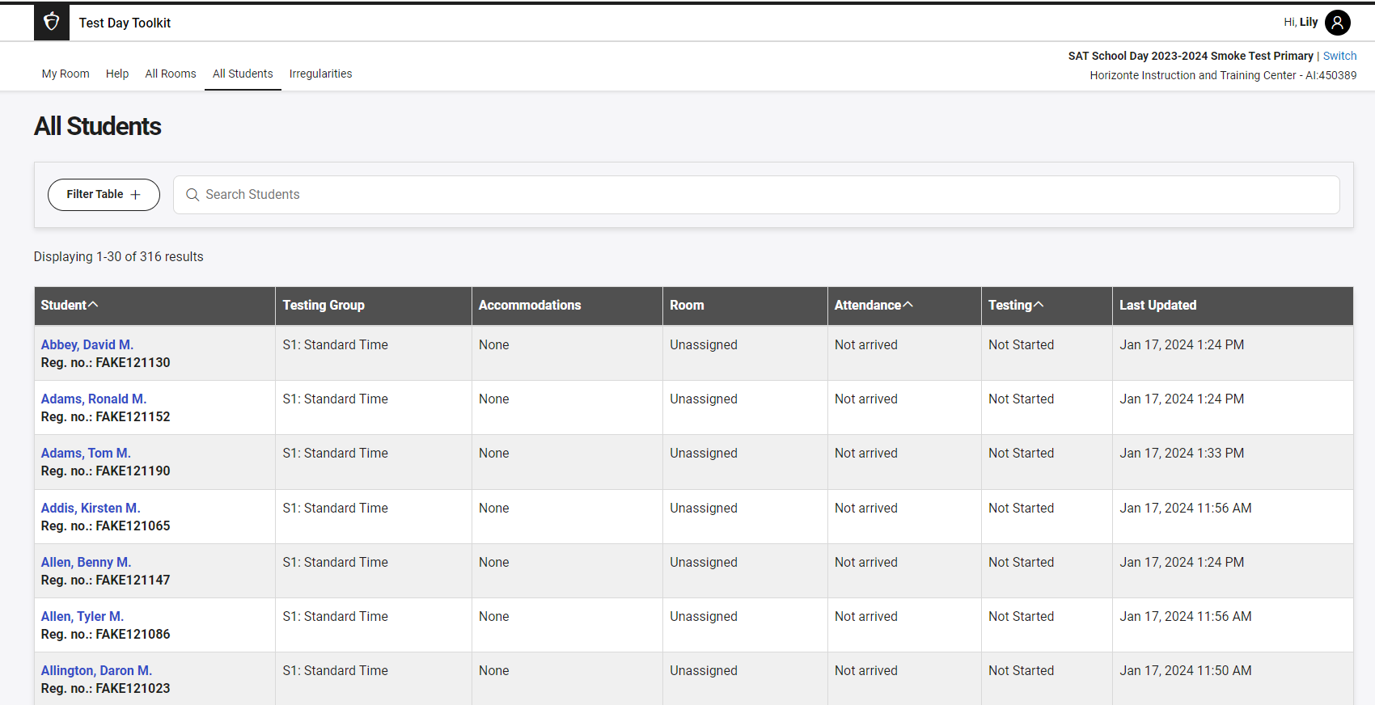
Part 2: Entering a Reason Not Tested Code
Start from the All Students tab and click on the student’s hyperlinked name.
Notes:
Our custom-built digital test application includes many test tools that are designed to improve the test experience for students, including:
A testing timer
A built-in Graphing calculator
The ability to flag questions they want to come back to
A simple navigator to jump to any question
A reference sheet of math formulas
Annotation via highlighter or note-writing
And Help and instructional screens
In addition, the app works with screen readers, and assistive technology. And there is a full list of keyboard shortcuts available for all users that will be especially helpful for users who navigate using a keyboard.
Bluebook includes a mark for review function, so students can flag any questions they want to come back to later.
A test timer is included at the top of the screen that shows how much time is left.

Slide 19
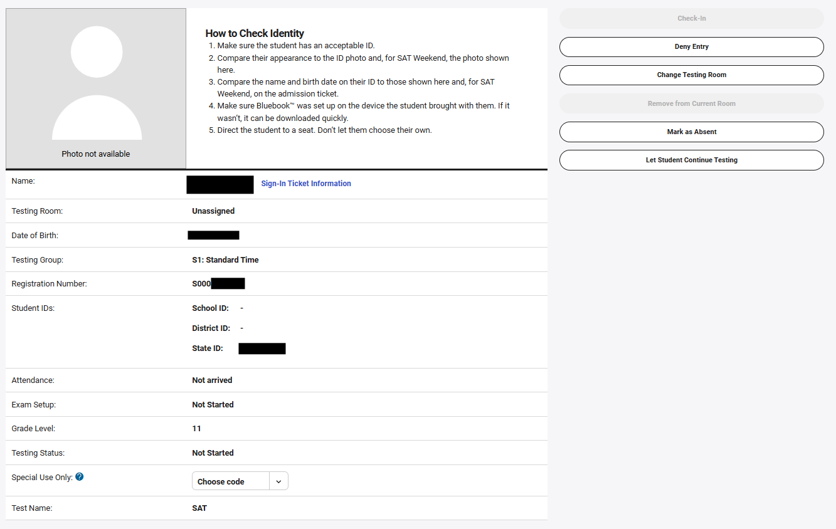
Special Use Only Code
Scroll to the “Special Use Only” field in the Student Profile.
Notes:
Our custom-built digital test application includes many test tools that are designed to improve the test experience for students, including:
A testing timer
A built-in Graphing calculator
The ability to flag questions they want to come back to
A simple navigator to jump to any question
A reference sheet of math formulas
Annotation via highlighter or note-writing
And Help and instructional screens
In addition, the app works with screen readers, and assistive technology. And there is a full list of keyboard shortcuts available for all users that will be especially helpful for users who navigate using a keyboard.
Bluebook includes a mark for review function, so students can flag any questions they want to come back to later.
A test timer is included at the top of the screen that shows how much time is left.

Slide 20
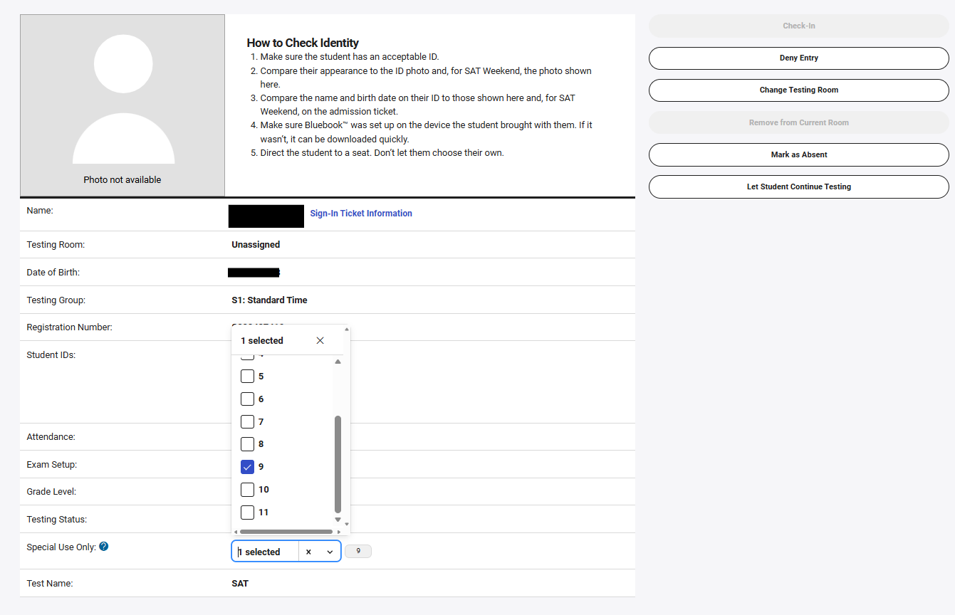
Selecting Code 9
Select code 9 (Parental Excuse) for the student.
Notes:
Our custom-built digital test application includes many test tools that are designed to improve the test experience for students, including:
A testing timer
A built-in Graphing calculator
The ability to flag questions they want to come back to
A simple navigator to jump to any question
A reference sheet of math formulas
Annotation via highlighter or note-writing
And Help and instructional screens
In addition, the app works with screen readers, and assistive technology. And there is a full list of keyboard shortcuts available for all users that will be especially helpful for users who navigate using a keyboard.
Bluebook includes a mark for review function, so students can flag any questions they want to come back to later.
A test timer is included at the top of the screen that shows how much time is left.

Slide 21
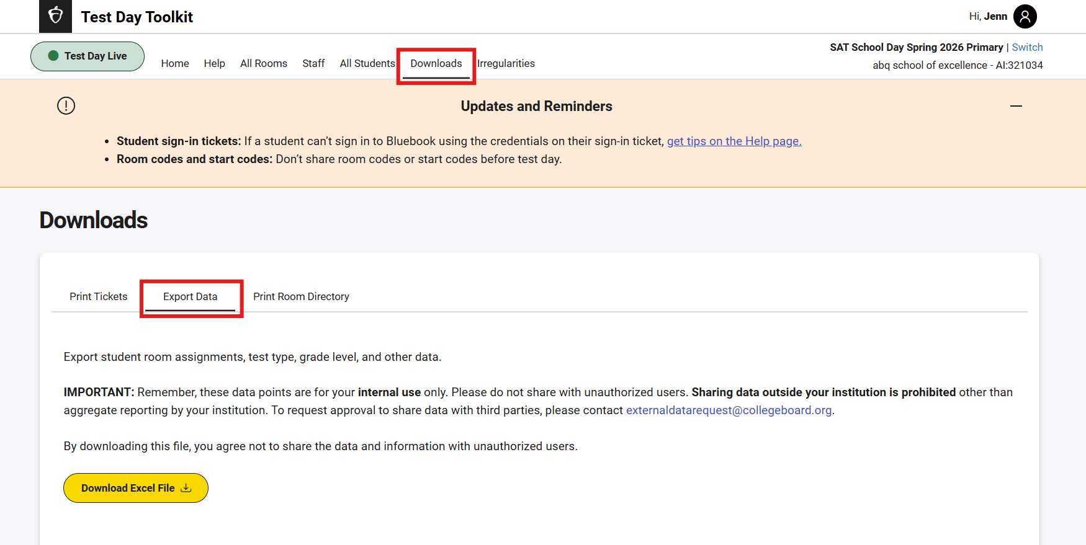
Using the Data Export
From the Downloads tab, you can export a roster of students to see which students have Reason Not Tested Codes assigned.
Notes:
Our custom-built digital test application includes many test tools that are designed to improve the test experience for students, including:
A testing timer
A built-in Graphing calculator
The ability to flag questions they want to come back to
A simple navigator to jump to any question
A reference sheet of math formulas
Annotation via highlighter or note-writing
And Help and instructional screens
In addition, the app works with screen readers, and assistive technology. And there is a full list of keyboard shortcuts available for all users that will be especially helpful for users who navigate using a keyboard.
Bluebook includes a mark for review function, so students can flag any questions they want to come back to later.
A test timer is included at the top of the screen that shows how much time is left.

Slide 22
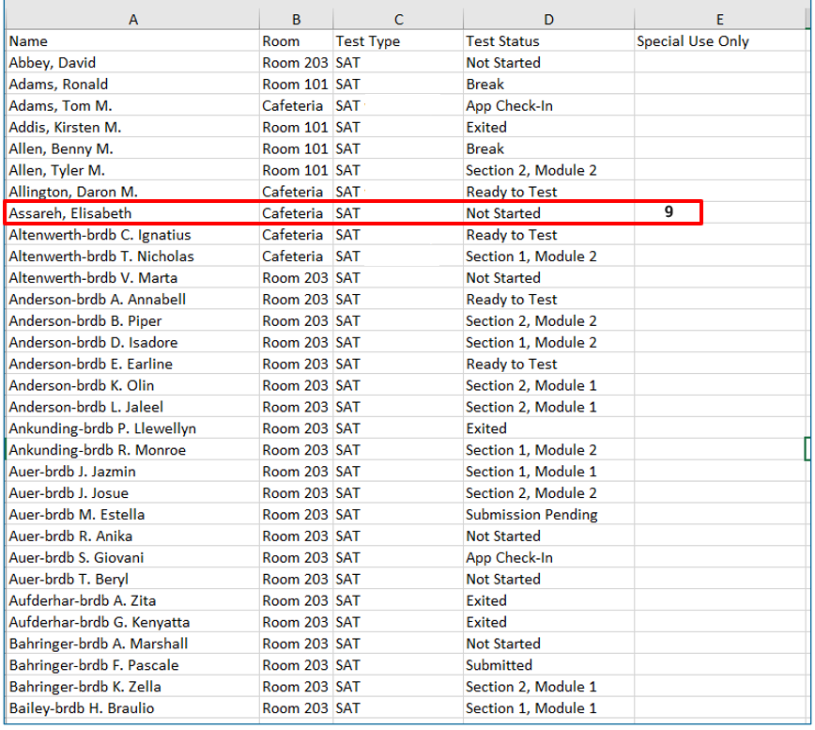
Data Export
In this exportable roster, you can see:
Assigned Reason Not Tested Codes
Test type
Room
Test Status
CDE recommends printing a copy of this list with Reason Not Tested Codes assigned and securely storing for your records.
Notes:
Our custom-built digital test application includes many test tools that are designed to improve the test experience for students, including:
A testing timer
A built-in Graphing calculator
The ability to flag questions they want to come back to
A simple navigator to jump to any question
A reference sheet of math formulas
Annotation via highlighter or note-writing
And Help and instructional screens
In addition, the app works with screen readers, and assistive technology. And there is a full list of keyboard shortcuts available for all users that will be especially helpful for users who navigate using a keyboard.
Bluebook includes a mark for review function, so students can flag any questions they want to come back to later.
A test timer is included at the top of the screen that shows how much time is left.

Slide 23
Timeline
March 2 – April 30
May 1 – May 8
May 8, 10:59PM
School Test Coordinators and District Assessment Coordinators (DACs) can enter Reason Not Tested Codes in Test Day Toolkit.
Codes will flow into State Data Management System on a regular basis.
Test Day Toolkit is closed to adding/editing Special Use/Reason Not Tested Codes.
State Data Management System(SDMS) opens for DACs to make edits/additions to Special Use/Reason Not Tested Codes.
Any changes/updates do not flow back to Test Day Toolkit.
State Data Management System Closes for editing special use/reason not tested codes.

