Slide 1

Spring 2026 Student SAT® Suite: PSAT 10
Digital Readiness Check

Slide 2

Student Readiness Check
Purpose of the Student Readiness Check:
Ensure devices being used for testing meet technical requirements
Ensure Bluebook is installed correctly
Complete Exam Set-Up process
  Review of test taker rules
  Includes providing optional test taker information
  Participation in BigFuture School and opt-in to Connections
Complete Test Preview or Full-Length Practice Test
  Explore universal tools
  Answer sample questions
The readiness check will take approximately 15-20 without a full-length practice test.

Slide 3
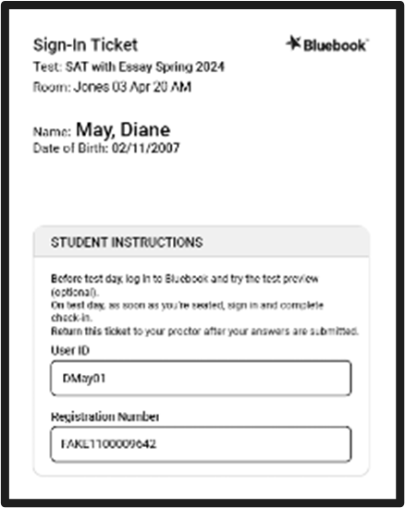
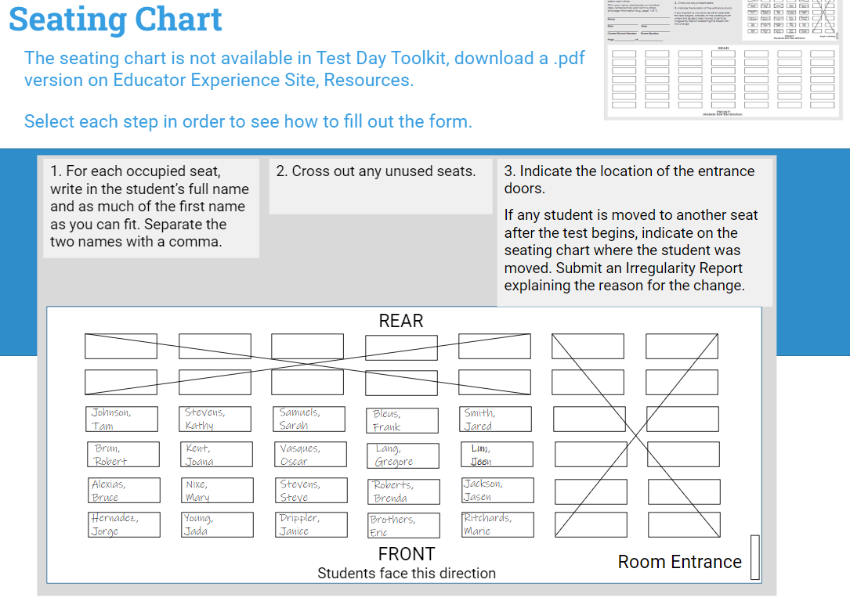
Take Your Seat and Receive Your Sign-In Ticket
The proctor will give you a sign-in ticket
Take your assigned seat
Notes:
Student readiness check can be administered during a regular class with regular seating.

Slide 4


Power On Your Device & locate Bluebook™
Bluebook will either be an icon on your desktop
Or in your app menu
If you don’t see Bluebook on your desktop or in the app menu, restart your device.

Slide 5
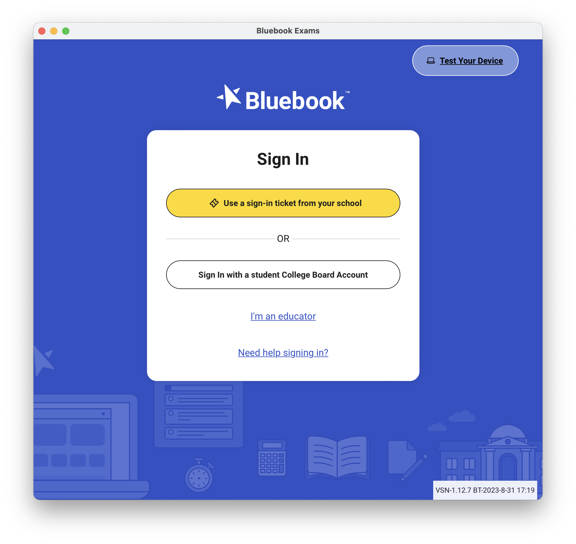
Test Your Device
Test your device before you sign in by selecting the Test Your Device button

Slide 6
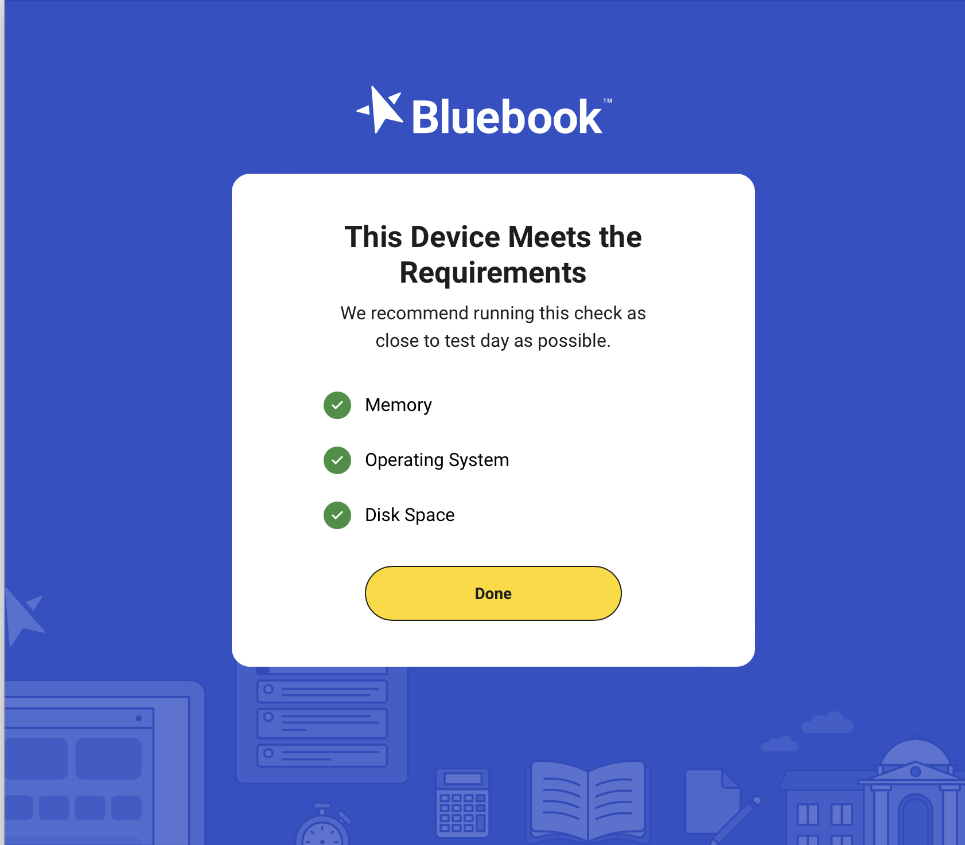

Test Your Device
If the device meets the requirements, select Done.
If the device does not meet the requirements, let your proctor know.

Slide 7
Sign into Bluebook
It is now time to sign in to Bluebook using the sign-in ticket you were provided.
You are signing in to set up for test day.

Slide 8
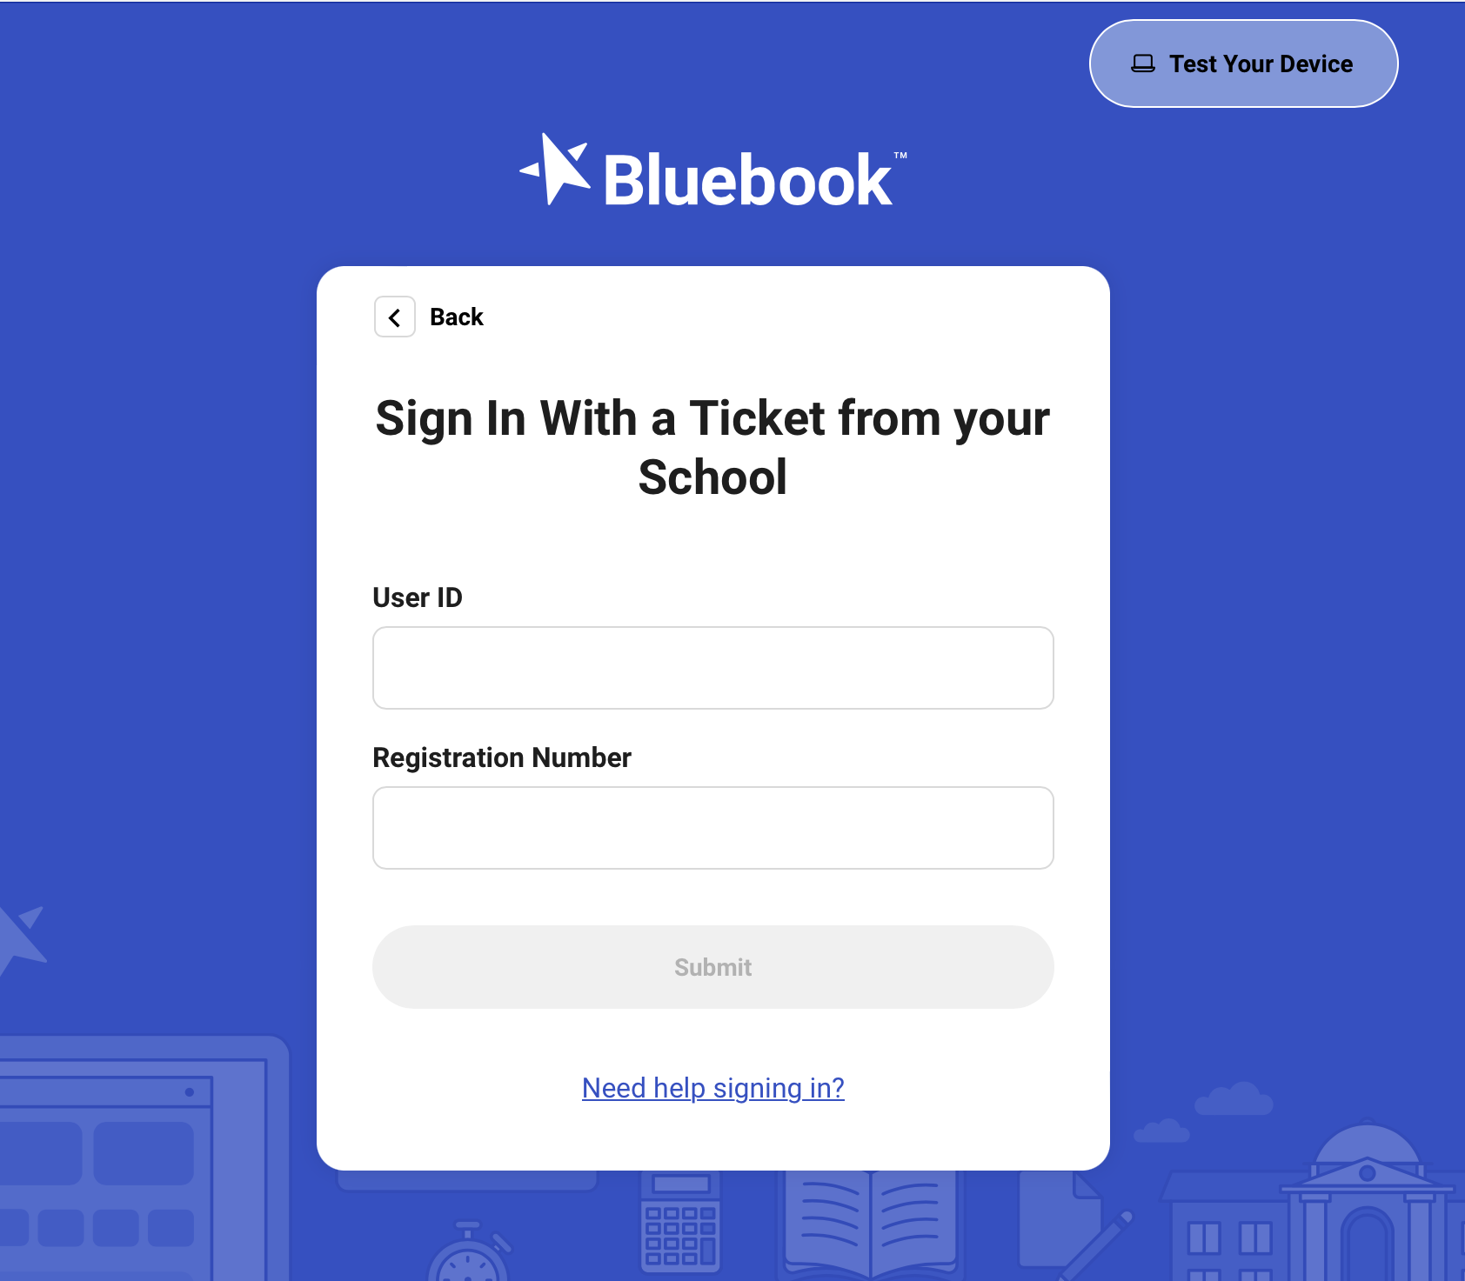
Sign into Bluebook
Your sign in ticket will have:
Your user ID
Your Registration Number

Slide 9
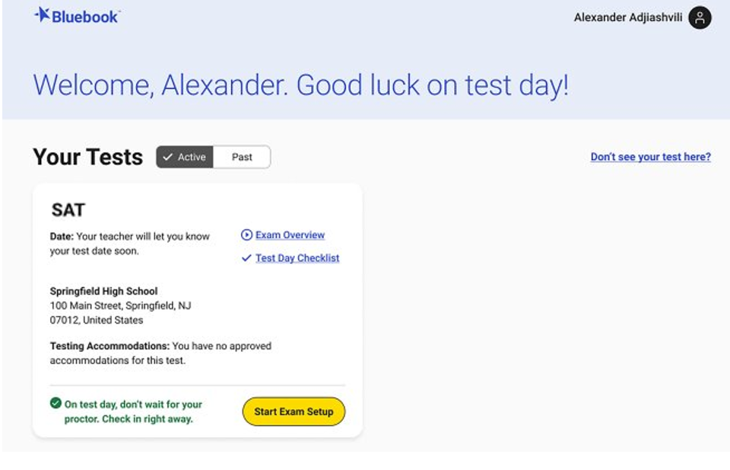
Compare Your Test Ticket and Bluebook
Ensure the correct test is displayed.
PSAT 10
Ensure the correct school name is displayed.
(If applicable) Check that the correct accommodation/s are displayed

Slide 10
Start Exam Setup
If your test ticket and information in Bluebook match, you are ready to select Start Exam Setup.
PSAT 10

Slide 11
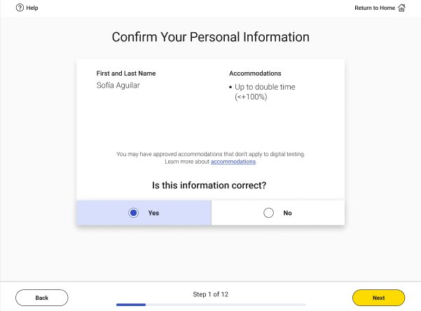
Step 1: Students Confirm Personal Information
Confirm that your name and approved accommodations (if applicable) are listed​. Then, click Next.
NOTE: If your accommodations look inaccurate, let me know. We cannot continue with exam setup until all issues are resolved.​
Notes:
On the first step of the Digital Readiness Check you will be asked to confirm that your personal information is correct
Review the screen and make sure that the following information is right:
Your Name (First and Last)
Accommodations* (if you have any*)
If all the information is correct, click the yes button.
If no, raise your hand and let me know.

Slide 12
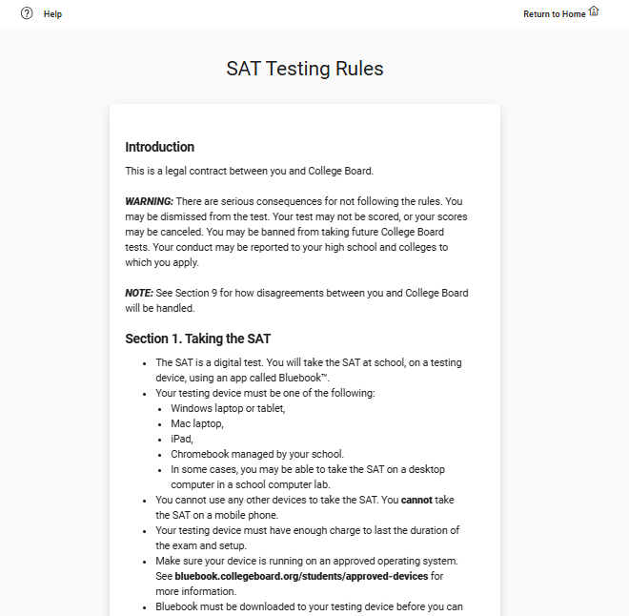
Step 2: Review & Agree to Test Taker Rules
PSAT 10 Testing Rules
Read and agree to the testing rules for the exam​. Type in the statement of agreement. Then, click Next.
Notes:
On step two, you are going to read and agree to the Test Rules.
This is an important agreement between you and College Board.
Read each rule carefully.
When you are finished, click “Yes.”

Slide 13
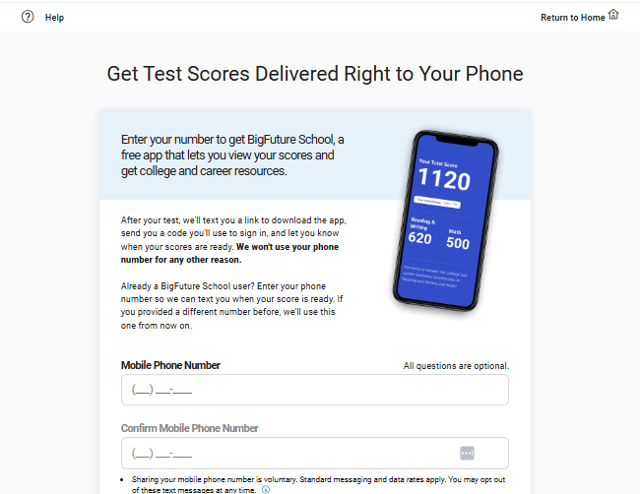
Step 3: BigFuture School Participation (Optional)
If you want to, you can opt-in to in BigFuture School, a free app that will allow you to see your scores on your phone when they are ready. To opt-in, enter your cell phone number, and click Next.
A signed data consent form needs to be on file with your school before opting into BigFuture School. Consent forms can be found on the CDE Assessment Webpage.
If you do not want to opt-in, do not enter your cell phone number, and click Next.
Notes:
On step three, you may enter your phone number to get the BigFuture School app.
The BigFuture School app lets you view your scores and gain access to college and career resources.
You will receive 2 text messages – 1 to download the app, and 1 when your scores are ready.
You cannot go back and opt-in after the test.
If you opted into BigFuture School App in another administration (like fall PSAT/NMSQT) you have to re-opt-in for spring testing.
These questions are optional.

Slide 14
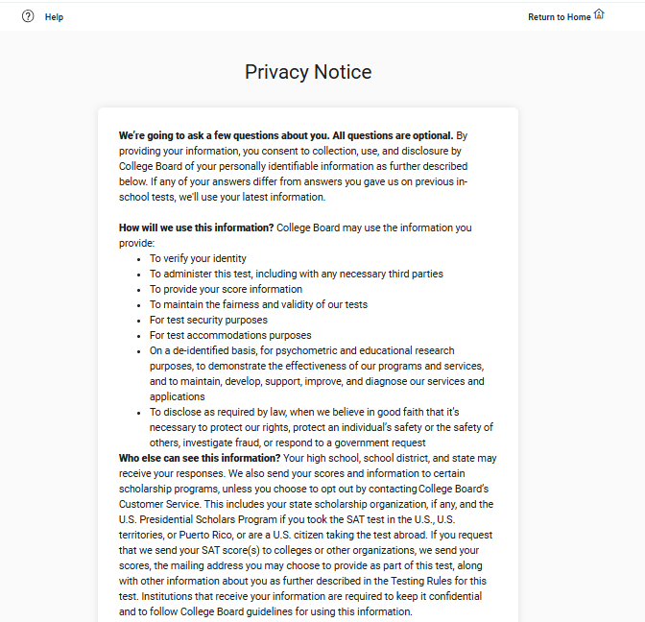
Step 4: Privacy Notice
Review the privacy notice. Then, click Next.​
Notes:
On step four, you will review and agree to the Privacy Notice.
You will learn how College Board will protect your personal information.
When you finish reading, click the yes button.

Slide 15
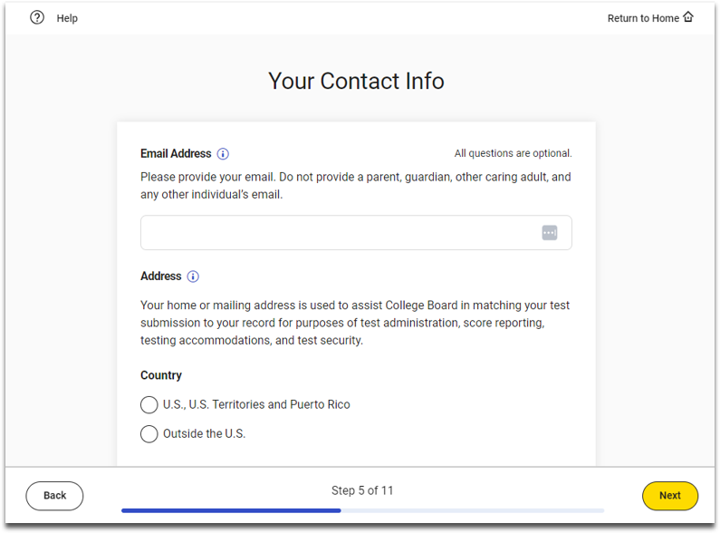
Step 5: Optional Student Information
If you want to, you may provide optional contact information, and then click Next.
If you do not wish to provide the optional information, simply click Next.
Notes:
On step five, you will be asked to provide your contact information. These questions are optional.
This information will be used to keep your test and test scores secure.

Slide 16
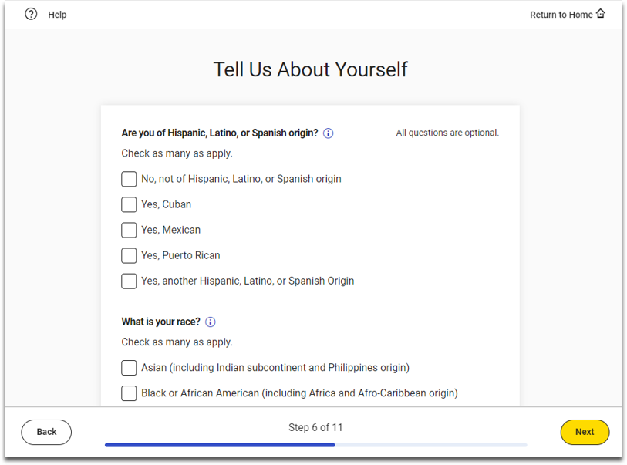
Step 6: Optional Student Information
On the screen that says Tell Us About Yourself, you may provide optional information about your demographics. Then, click Next.
If you do not wish to provide the optional information, simply click Next.
Notes:
On step six, you are asked to provide a little more information about yourself, like languages spoken at home. These questions are optional.

Slide 17
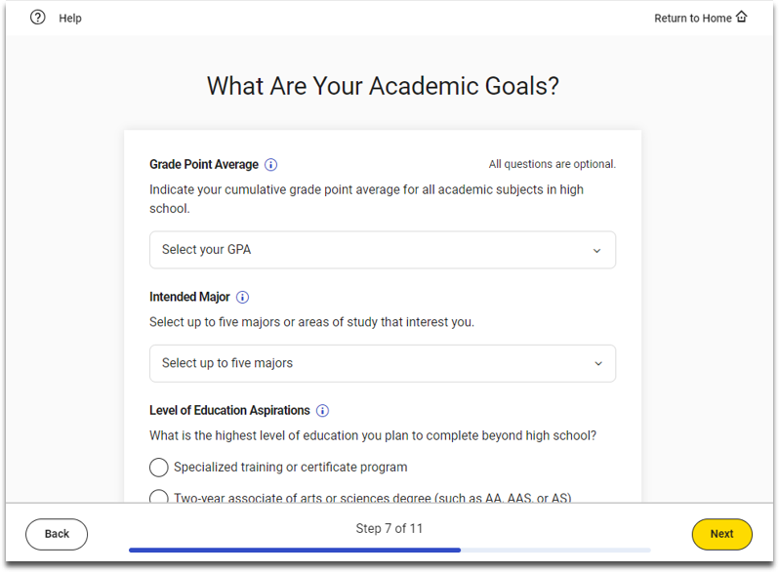
Step 7: Optional Student Information
Now, you may provide optional information about your academic goals. Then, click Next.
If you do not wish to provide this optional information, simply click Next.
Notes:
On step seven, you are asked to provide information about your academic goals. These questions are optional.

Slide 18
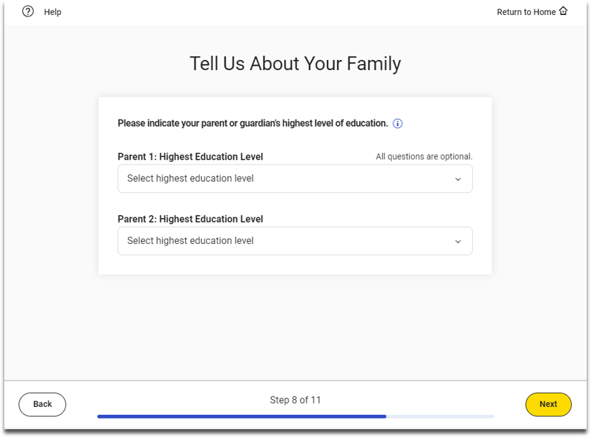
Step 8: Optional Student Information
On the screen that says Tell Us About Your Family, you may provide optional information about your family. Then, click Next.
If you do not wish to provide this optional information, simply click Next.
Notes:
On step eight, you are asked to tell us a bit more about your family. These questions are optional.

Slide 19
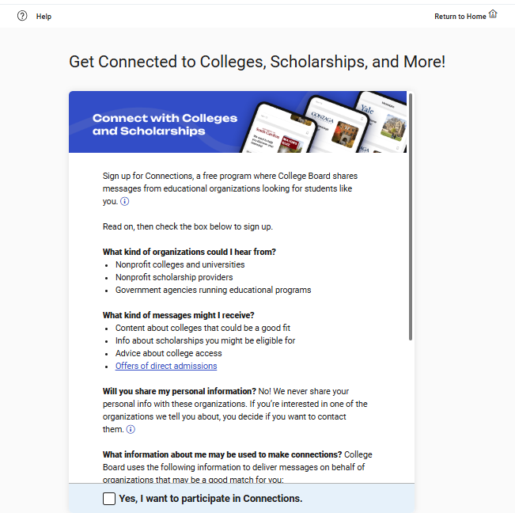
Step 9: Connections Opt-In (Optional)
Just like BigFuture School, Connections is free and optional. If you want to opt-in to Connections (which will allow you to get information about colleges, universities, and scholarship organizations), select the box that says “Yes, I want to participate in Connections” and click Next.
A signed data consent form needs to be on file with your school before opting into Connections. Consent forms can be found on the CDE Assessment Webpage.
If you do not want to opt-in, do not select the box, and click Next.
Notes:
On step nine, you will be asked to sign up for Connections.
Connections is a free program that connects you to scholarships, information about colleges, universities and career programs that may be a good fit for you.
Click on the checkbox to sign up for Connections.

Slide 20
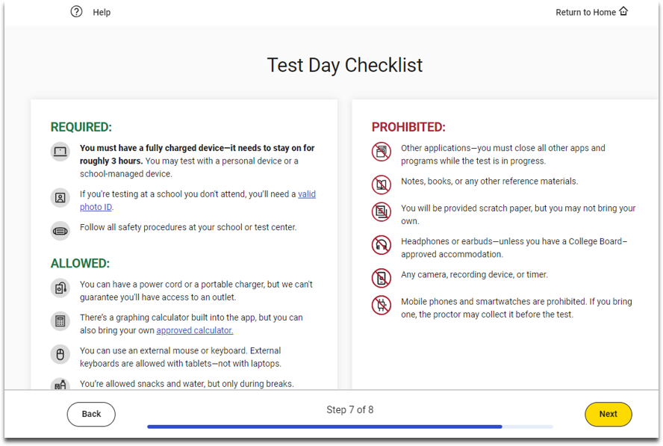
Step 10: Test Day Checklist
Review the Test Day Checklist and click Next.
Notes:
On step ten, you will see valuable information about:
What you NEED to bring to test day.
Items allowed on test day.
Items prohibited on test day.

Slide 21
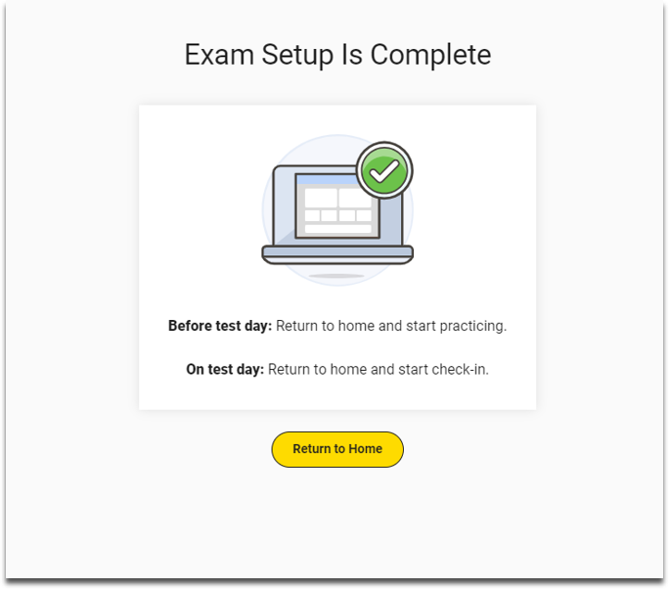
Step 11: Exam Set-Up Complete
Exam Setup is now complete.
Click Return to Home.
Notes:
You successfully have set-up Bluebook, and your device is ready for test day!

Slide 22
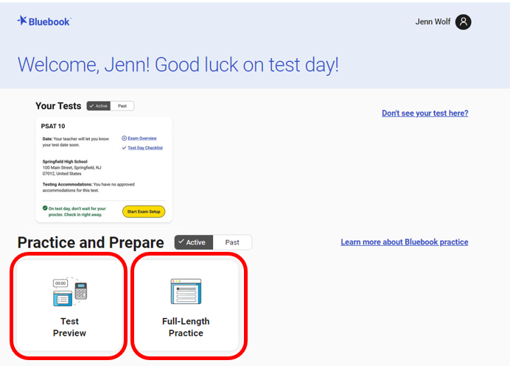
Test Preview and Full-Length Practice Test
Test Preview: A sample of questions from Reading & Writing and Math. Approximately 10-15 minutes in length. Not scored. No accommodations are available . Embedded Text-to-Speech is available.
Full-Length Practice: Timed, full length practice SAT and PSAT tests. Scored. Accommodations available. Embedded Text-to-Speech available.
Paper full-length practice tests are also available to download via Full-Length Practice.
Note: While full-length practice tests are timed, students can move ahead or return to previous sections.

Slide 23
Your Student Readiness Check is Complete

