Slide 1
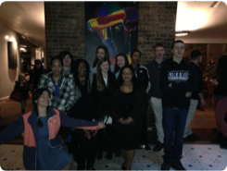
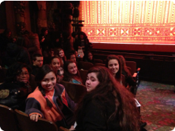
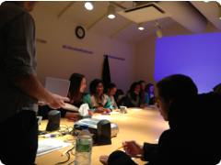
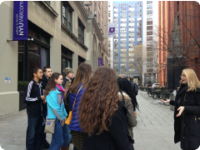
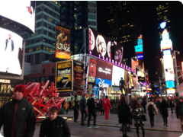
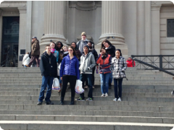
Advanced Placement Scholar Pathways
Preparing College & Career Ready Students
Amy Vadella, Pocomoke High School
Pocomoke, MD

Slide 2
Our School At A Glance
Total Enrollment : 336
Native American | 2/336 | <1%
Asian | 5/336 | 1.5%
African American | 146/336 | 43%
White | 156/336 | 46%
Two or More | 22/336 | 7%
Hispanic | 5/336 | 1.5%
FARMS | 188/336 | 56%

Slide 3
What is the Pathways Program?
Clear direction on how to create a reputable high school transcript
Cohort style learning environment
Rigorous coursework
Fun & exciting field experiences
Technology infused (one-to-one Ipads)

Slide 4
Two Distinct Pathways
Math/Science
  AP World History
  AP Biology
  AP Calculus AB/BC
  AP Statistics
  AP Chemistry
  AP Physics C
Humanities
  AP World History
  AP US History
  AP Psychology
  AP Statistics
  AP Foreign Language
  AP Art
Schedules are built by hand and can be customized with any combination of courses

Slide 5
Rigorous Curriculum
College level coursework at an early grade level
Enhances critical reading and writing skills
Prepares students for success in college, including competitiveness in the college application process
Scheduling options that allow students to obtain the pre-requisites needed to enroll in coursework that interests them

Slide 6
Latin
60% of the English language is based on Latin and Greek
Latin contributes to the literacy and communications skills of students
Latin will increase student’s vocabulary and help them better understand their native language
Studies have shown that students who took Latin out performed their peers on the verbal and writing portions of the SAT by 130 points on average (Richard LaFLeur)

Slide 7
College Benefits
Students can earn three (3) or more college credits for each Advanced Placement Exam passed, depending on the specific score and the college of choice
  Decreased freshman year course load
  College coursework options
  Early college graduation
  Financial benefits

Slide 8
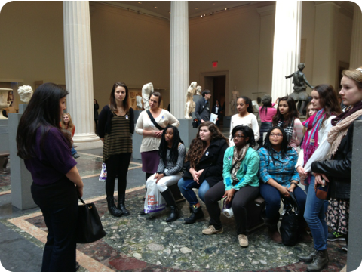
Field Experiences
Designed to enhance understanding and connect classroom learning to the real world
One culminating field experience each year
  New York City
  Gettysburg
  Washington D.C.
  France

Slide 9

Pocomoke High School’s Advanced Placement Pathway will
prepare YOU to be competitive, college & career ready! students!

